Slide 1
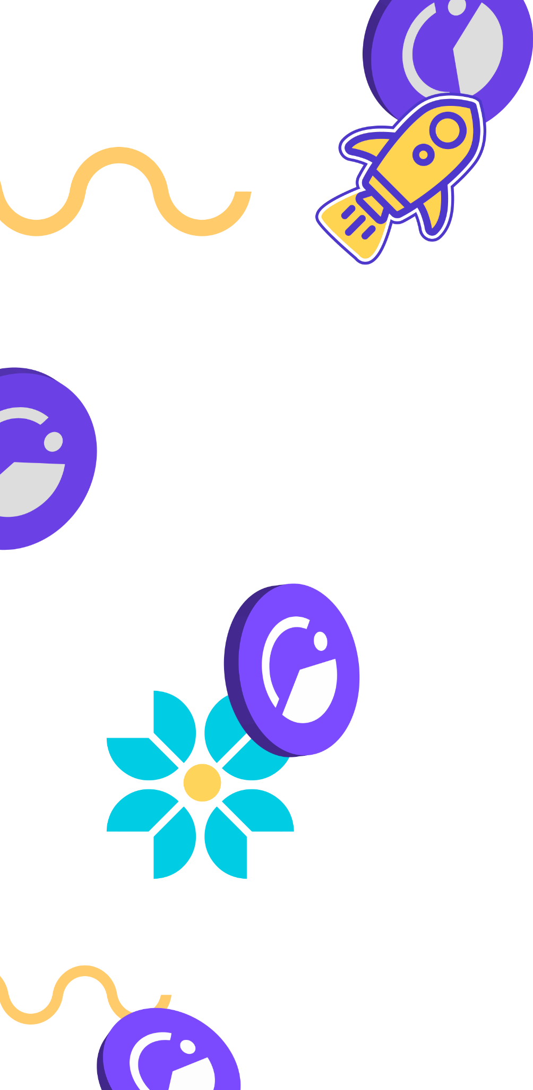
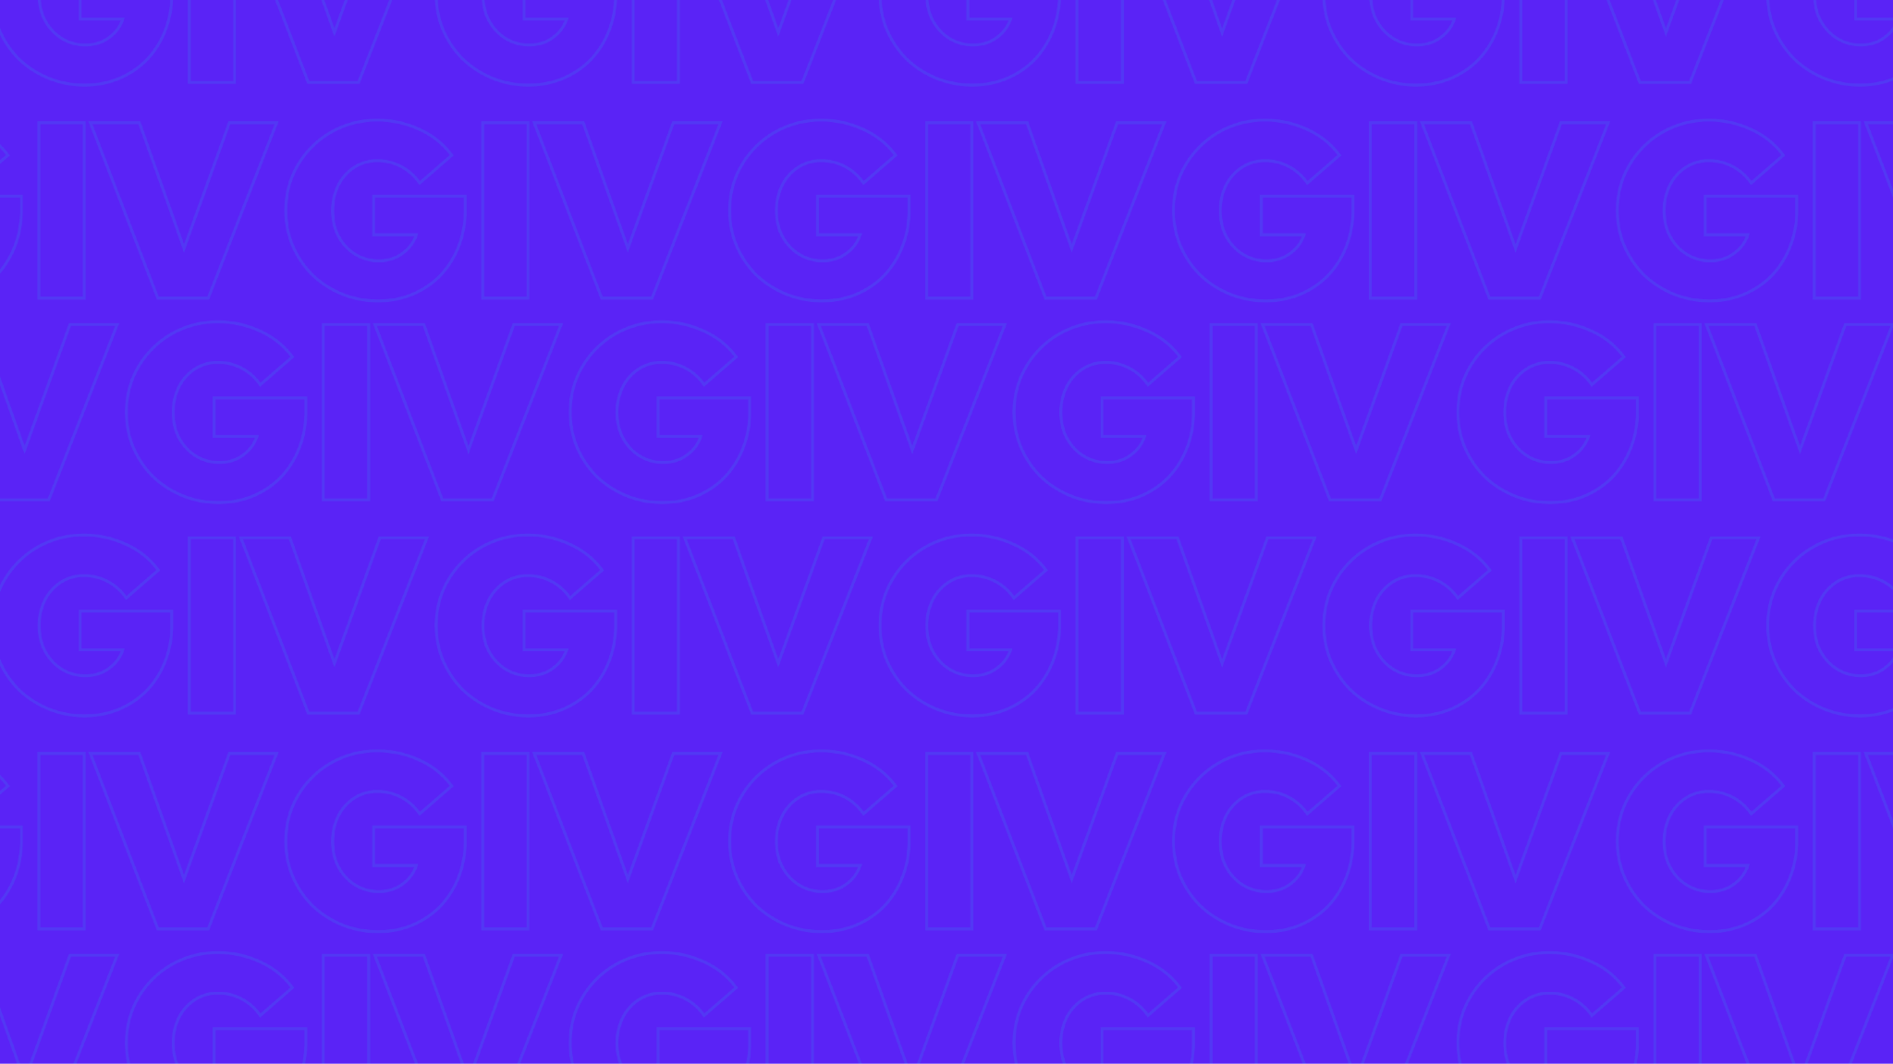
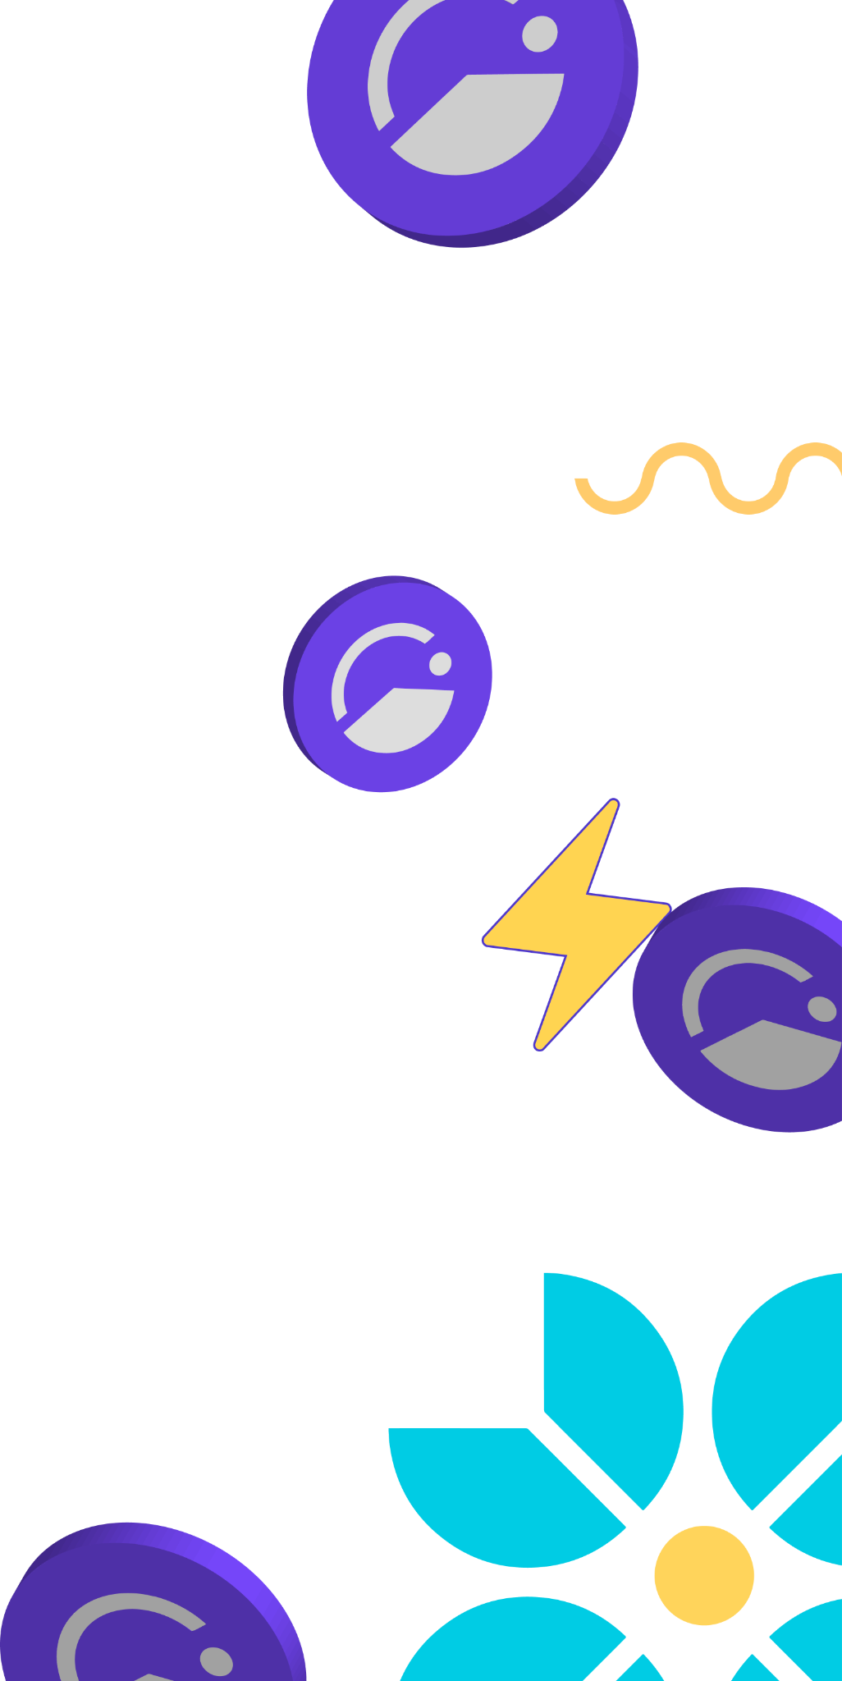

Giveth is rewarding and empowering those
who give to projects, to society, and to the world!
Giveth is rewarding and empowering those who give to projects, to society, and to the world!

Slide 2
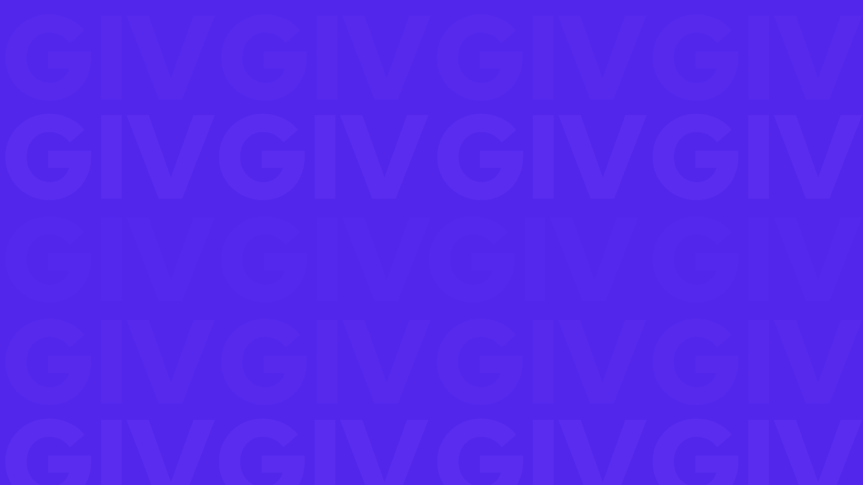
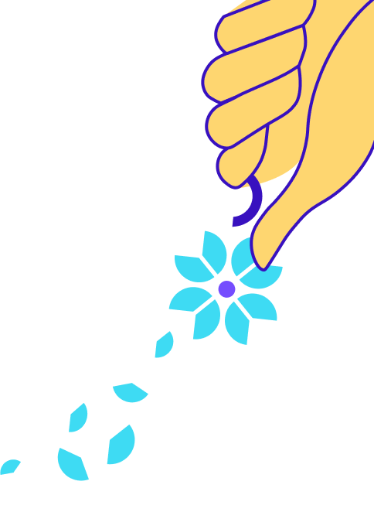
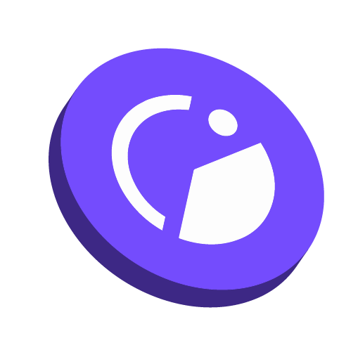
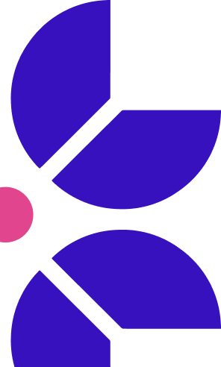






Using web3 to evolve philanthropy
Giveth has the best donation platform in the world & MORE!
Giveth provides value and benefits everyone involved:
non-profits
non-profits
donors
stakeholders
Impact DAOs
100% donations go from donors to projects anywhere in the world.
Donors get up to 80% of their donation back with GIVbacks. (Incentive program that rewards donors with GIV.)
GIV holders can earn a yield participating in the GIVeconomy.
ReFi organizations can reward their community with Regen Farms.

Slide 3

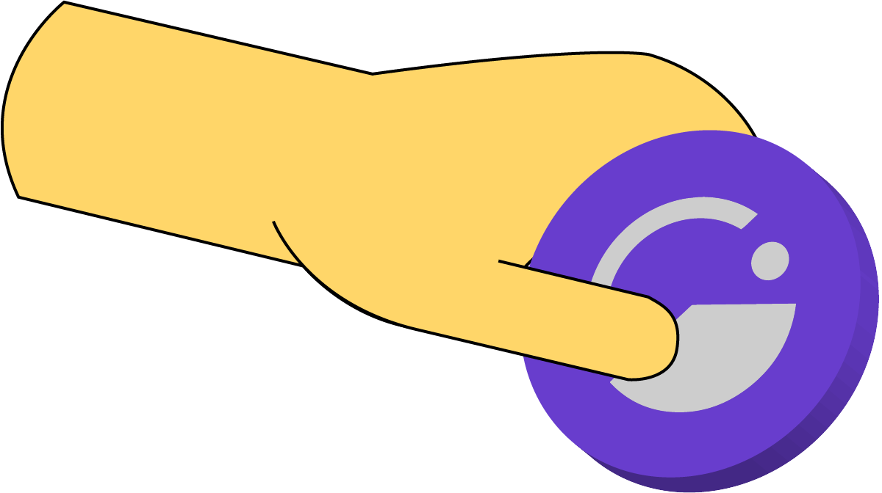



Our Vision
Giving is effortless. People & organizations around the world are rewarded for creating positive change.
Griff Green @thegrifft

Slide 4

The Problem: philanthropy is broken
Hardly grows & is based on sacrifice.
Nonprofits are overwhelmed & under-resourced.
They are in an underfunded, unsustainable & fragile model that usually crashes when funding dries up. Furthermore, middlemen keep a big chunk of the money intended for impact.
Funders get donors fatigue, the have an opportunity cost & NO UPSIDE.
Incentives for donating are poor, They can make an ROI with impact investing.
It’s a LOSE-LOSE game
Griff Green @thegrifft

Slide 5
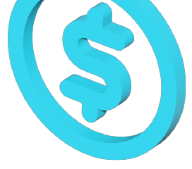

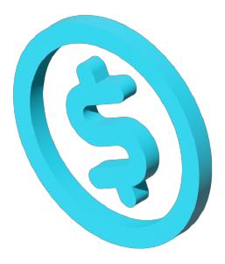


The Opportunity
$25 trillion/yr
SPENT worldwide on public goods
Over 25x Total Crypto Market Cap
Griff Green @thegrifft

Slide 6
Nonprofits
~$500 billion/yr
is donated in the US alone
Griff Green @thegrifft

Slide 7
Giveth as a service provider
A service which enables everyone to grow and be rewarded by making the world a better place.
Better for non-profits
Better for donors
1. Access worldwide capital without fees.
2. GIVfi - Earn yield on idle donations.
3. Gurves - The engine behind regen economy, resilience through community & less dependence external funding.
1. GIVbacks - Rewards & upside on donations.
2. GIVpower - Yield on GIV & help projects beyond donations.
3. Invest in regen economies.
Now that’s a WIN-WIN game

Slide 8
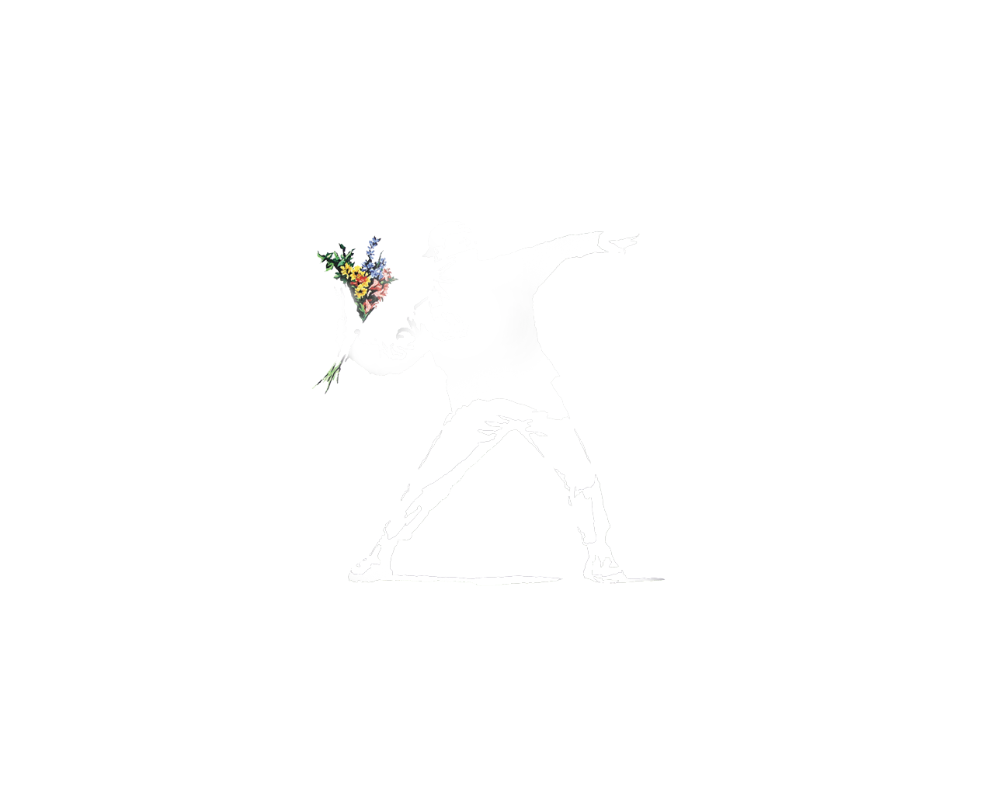
Giveth Mission
Evolve the nonprofit space
Build resilient regenerative economies powered by their community
and less dependent on donations or public funding
Provide the government services that people actually want
Give an upside to funding, supporting and even donating to public goods
Top down control loses legitimacy and fades away peacefully
Empower communities to develop efficient bottom-up managing structures.
Turning stakeholders into shareholders of public goods
Griff Green @thegrifft

Slide 9
Where do we start?
When governments fail to provide public goods that are in demand, people start nonprofits.
Griff Green @thegrifft

Slide 10
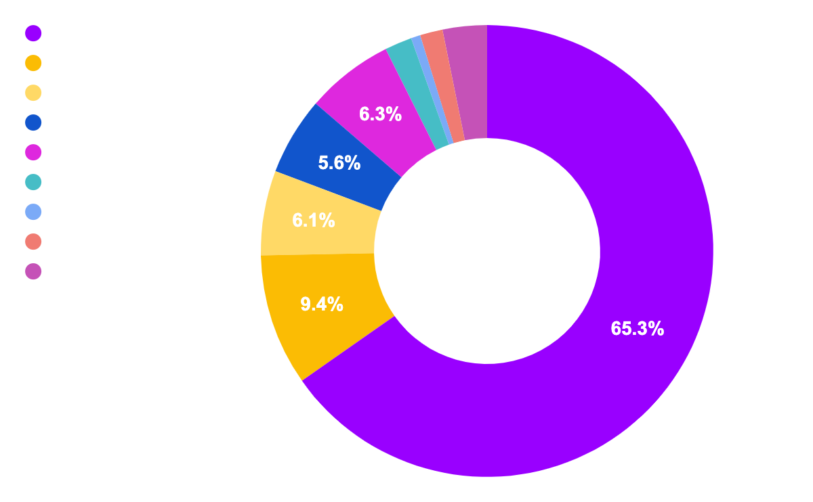
86% of our unique donors joined since March ‘21, and the numbers continue to grow!
Giveth in numbers
Total donated: $3,607,186 USD
# of projects: 2,209
# of donations: 14,327
# of unique donors: 6,138
$ 3,607,186
Total
Top 10 categories raised by total

Slide 11
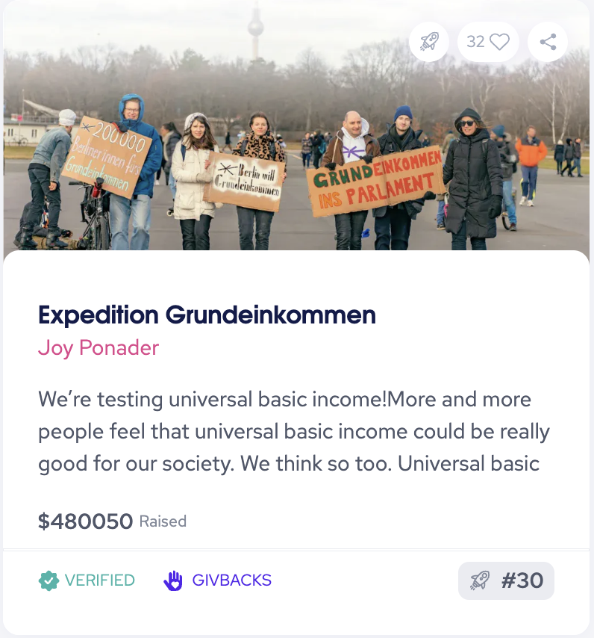
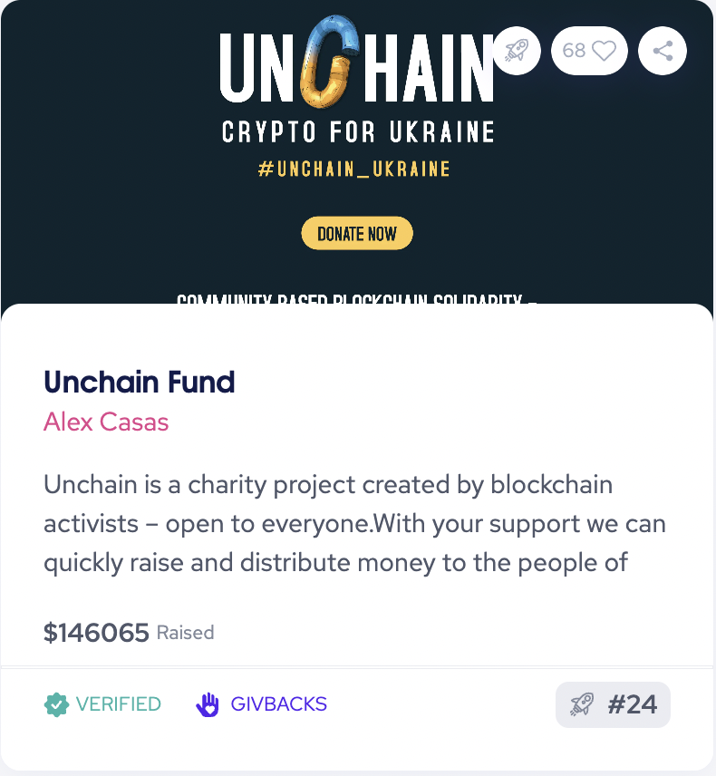
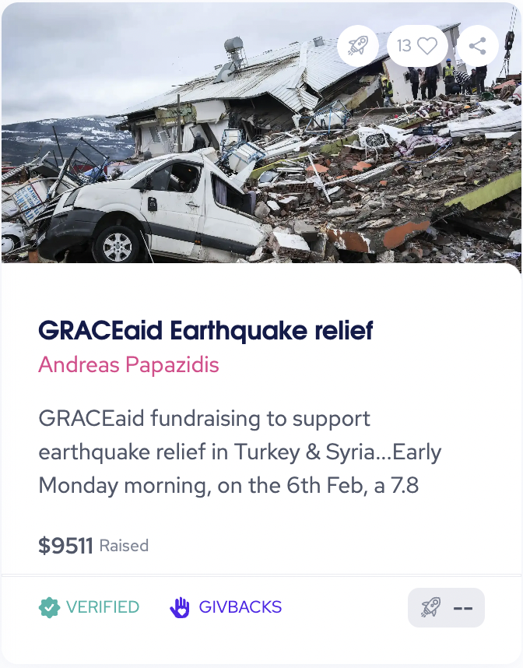
We are making global impact
Saving lives: 250K+ USD aid support to reputable non-profits in Ukraine, Turkey & Iran

Slide 12
Product.
Loom demo
Griff Green @thegrifft
Notes:
Sccript: Welcome to Giveth, we are building the future of Giving. Let’s see how the future of giving looks for projects raising funds: 1. Just click on create a project. 2. You will be asked the key intro information that a donor would like to know: Project name: Description: Don’t forget to add images and videos. They are worth a 1000 words. Speaking of words keep it short & sweet but add links.for those interested in digging further. Add the main impact categories. Your location. & the wallet address where you will get the funds. Click on accept & you are ready to do. 3. If you are making impact accessible to anyone, apply to get verified to offer the best deal to you donors. They will get rewarded with up to 80% of their donation on GIV our Regenerative economy token. Now let’s see the process for a donor. You would probably click on the link of the projects comms But you can also just come to giveth and look for a project.
You can browse by category or filter them. Let’s make a donation to X I can see their description, donations made, updates & ranking (curated by the community) Donate is simple, chose the token & amount (you can also change the chain), there you go.
& then just wait for the transactions to pass & now you are a giver. Now remember that I said that donating to verified project gets you rewards on GIV back? Let’s go claim them. Go to the GIVbacks tab on GIVeconomy and then click on claim. Now what to do with this GIV? Let’s invest it. Go to GIVfarm & invest it on GIVpower, click on stake, you get an interest of 10-50% this depends on how important it liquidity on your GIV for you. By default your token will give you the minimum interest, but completely liquid. You can choose to lock for up to a year in biweekly periods. Locking for a year, will give you the highest APR. Not only that, you will also have GIVpower a non-transferable token that you can use to vote for your favorite projects and help them rank higher. The ranking is how we curate the platform. Projects higher on the ranking show up on top on the platform & give more rewards. So that’s the UX at Giveth. Let’s sumarize the key takeaways: Projects get full access to capital. Global donations without fees. Donors get rewards, up to 80% of their donations back on GIV token. GIVholders (anyone with GIV) can invest to earn more tokens and upvote their favourite projects to support them with additional benefits. Soon: Projects will also earn rewards on stable coin (peg to USD) on their donations while they are idle.
& we will help them become DAO’s & launch their own token backed by the GIV of their supporters. Their economy will start with liquidity provided by their supporters, who will become investors in the regen economy.
So, this is how the future of giving looks like from where we stand. The future of giving is investing on regenerative economies. Join Giveth and build with us the future of Giving CTA

Slide 13
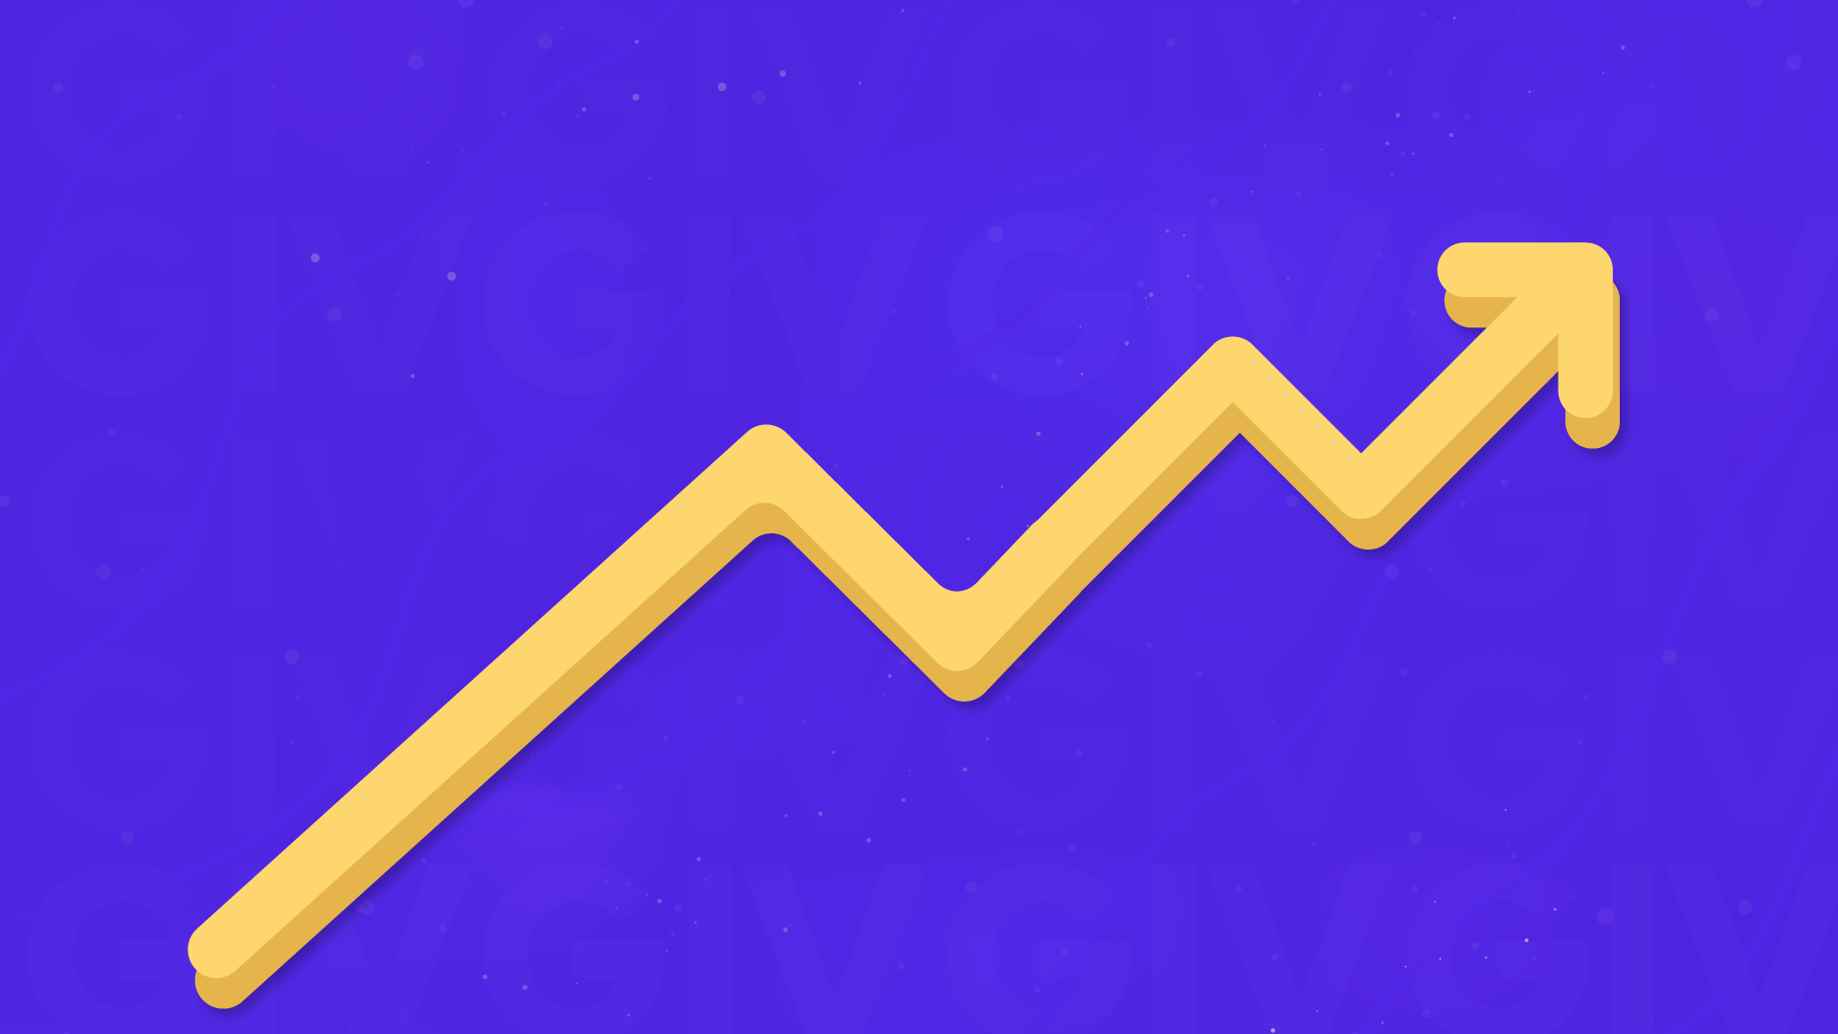
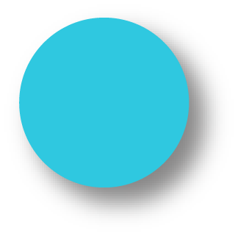
The 3 year Giveth Roadmap
GIVpower
Support projects & earn
GIVbacks
Donor rewards
Our DApp, unstoppable Donation Application
GIVfi
Revenue models integrated
Gurves
Projects become Impact DAOs collateralized by GIV
We are here
Griff Green @thegrifft

Slide 14
Our growth plan - the best is yet to come
HODL Vault and path to our stable token (oneGIV) To create more liquidity, we have launched oneGIV and the Giveth HODL Vault. This way we can protect the value of GIV for GIVbacks, the GIVgarden & all our future ventures. oneGIV is our own branded stablecoin and will be used throughout the GIVeconomy.
2022
GIVpower GIV holders can stake and lock their tokens to BOOST projects on our donation platform. The longer GIV holders lock, the more their favorite projects are BOOSTED and the higher their own staking APR.
2022
GIVfi a revenue model allowing funds on the platform from latent donations, endowments & savings accounts to generate yield through safe defi strategies. The interest will buy GIV on the open market.
2023
Gurves: Regen microeconomies powered by GIV With the GIV staked behind projects via GIVpower, we can enable for-good projects to launch their own microeconomies backed by GIV in a bonding curve. Donors become investors, volunteers become shareholders with a voice, and Giveth.io becomes the place to go for seed round impact investments. THE FUTURE OF GIVING IS INVESTING!
Future

Slide 15
Our growth plan - the best is yet to come
“The Givers” PFP Collection
NFTs that can be integrated into your Giveth profile. NFT holders also get a discount on Giveth domain names that can link to their account (yourname.giveth).
Giveth Referral Program
Grassroots affiliates and self-appointed community ambassadors can promote their favorite fundraising projects and receive major GIVbacks rewards when donations are made through their referral.
Fiat Donations
Opens the door wider to accessibility and web3 onramping.
Quadratic Funding
Joint collaboration between Giveth and Gitcoin, to build together towards our mutual goal of transforming public goods funding using web3. This integration will allow verified Giveth projects to benefit from additional funding from the Giveth Matching Pool, which can be substantial.
GIVfi
Revenue model allowing latent funds on the Giveth platform to generate yield through safe DeFi strategies. It is comprised of two products: GIVsavings and GIVdowments. Giveth will also use its part of the yield to buy GIV on the open market, engaging in the circular economy, which supports all GIV token holders!
Q1
Q3
Q3/Q4

Slide 16


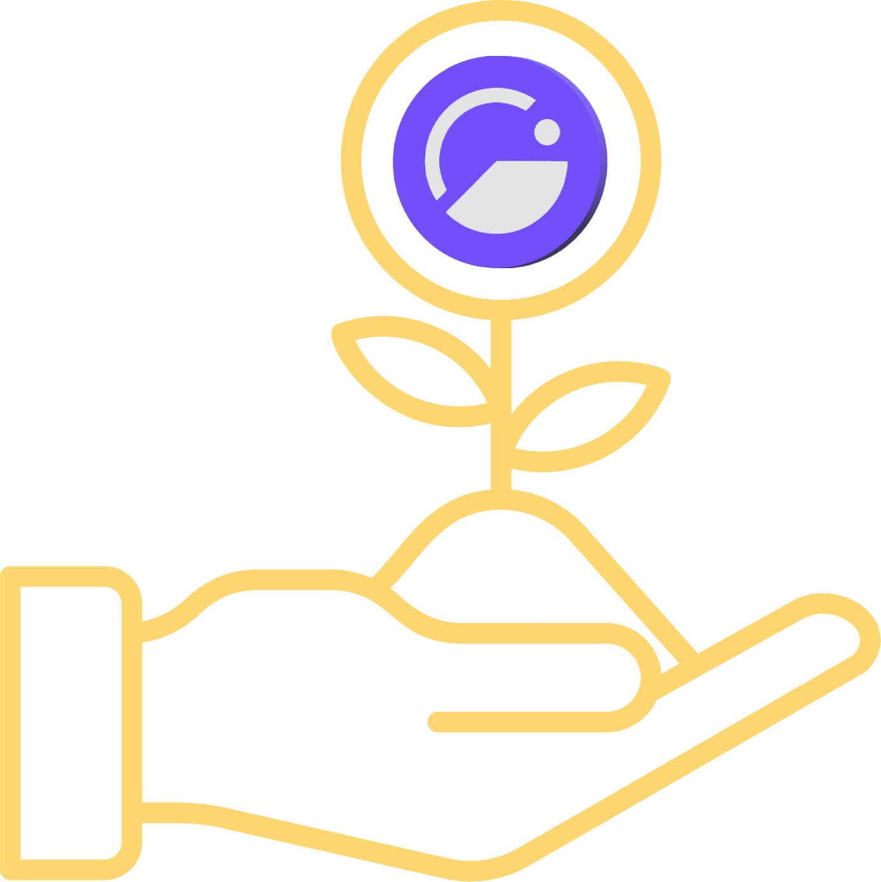
GIVfi
Bringing defi to nonprofits
Griff Green @thegrifft
Notes:
GIVbacks is a revolutionary concept that rewards donors to verified projects with GIV tokens. When you give to verified projects you get GIV tokens and you get a Stream of GIV tokens for the next 4 years. This means that not only does Giveth reward you for donating, if the GIV token price goes up, you could actually make more money than you donated! What more could you want?

Slide 17
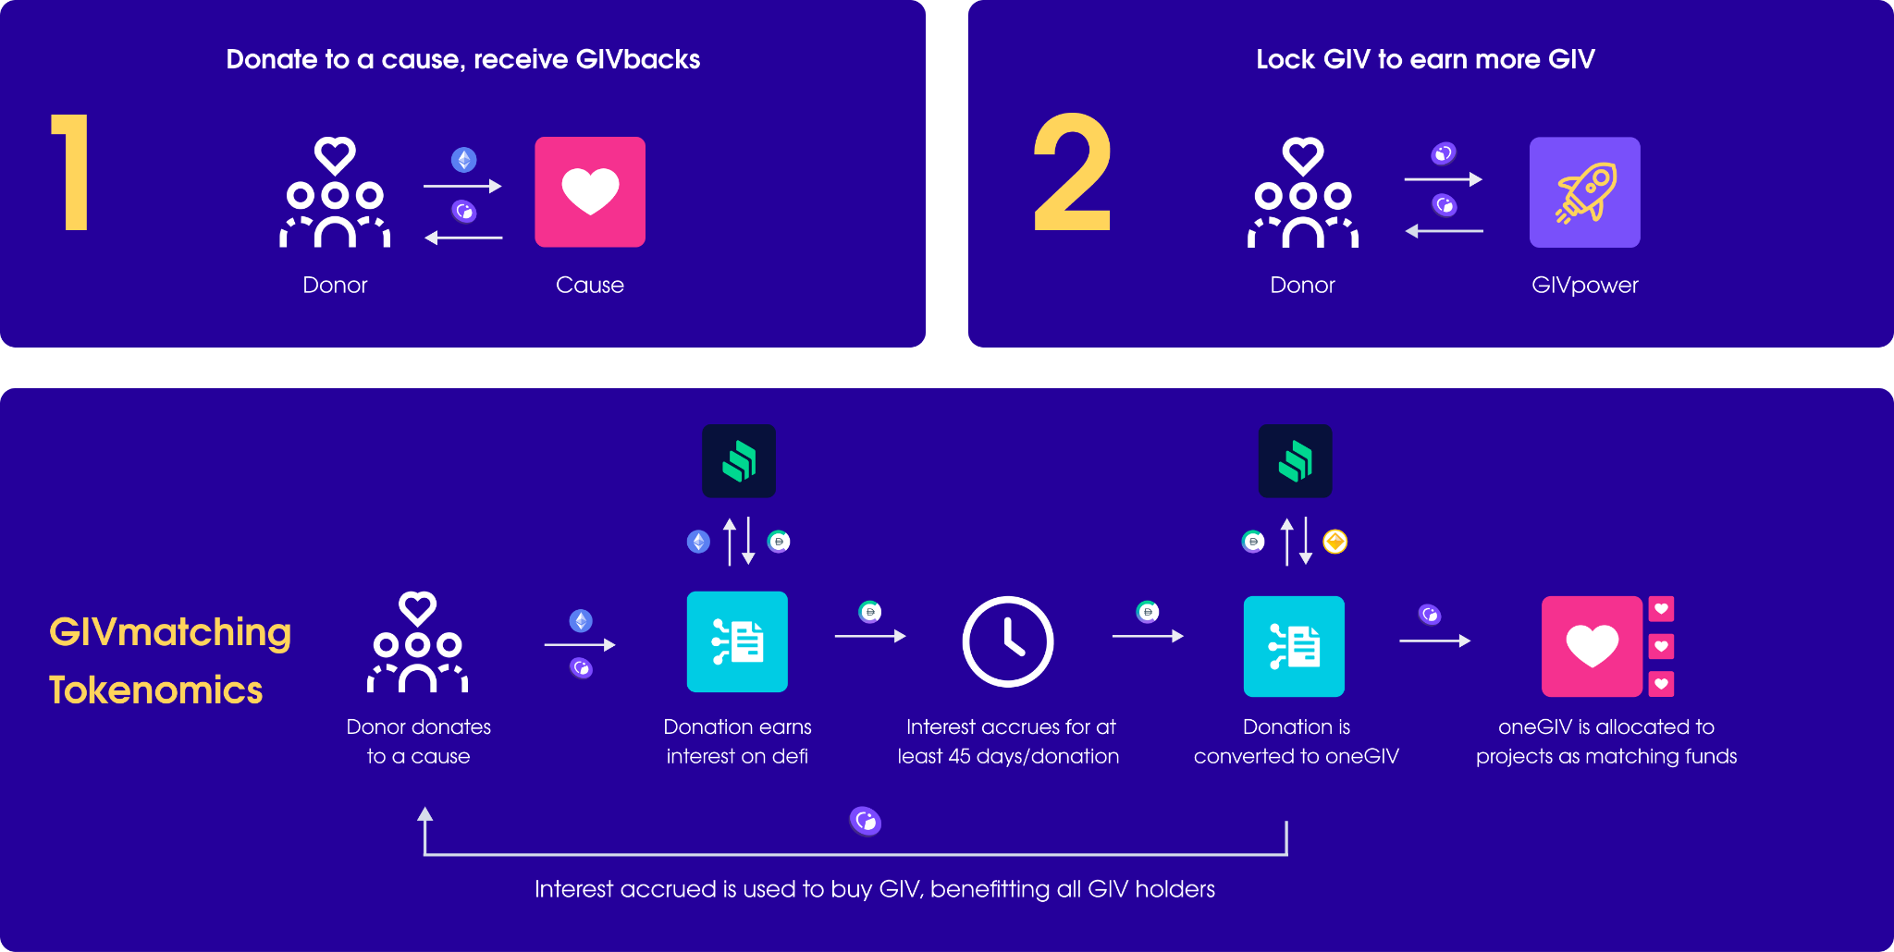
GIVfi + GIVmatching

Slide 18
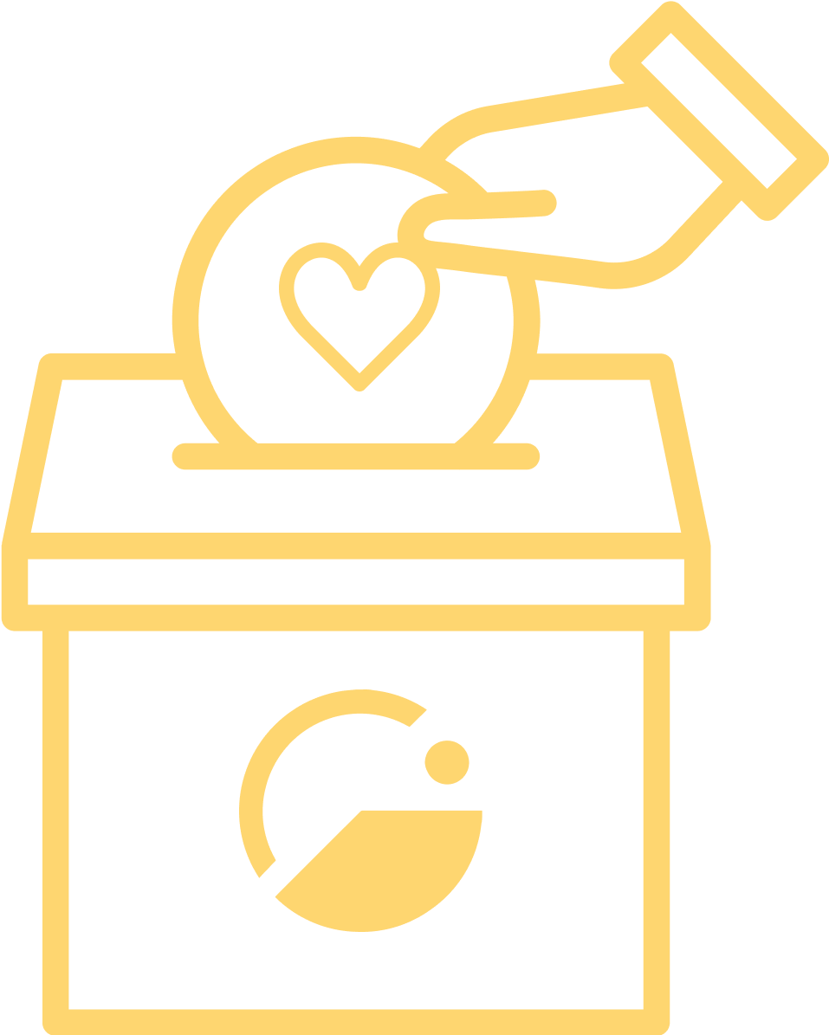
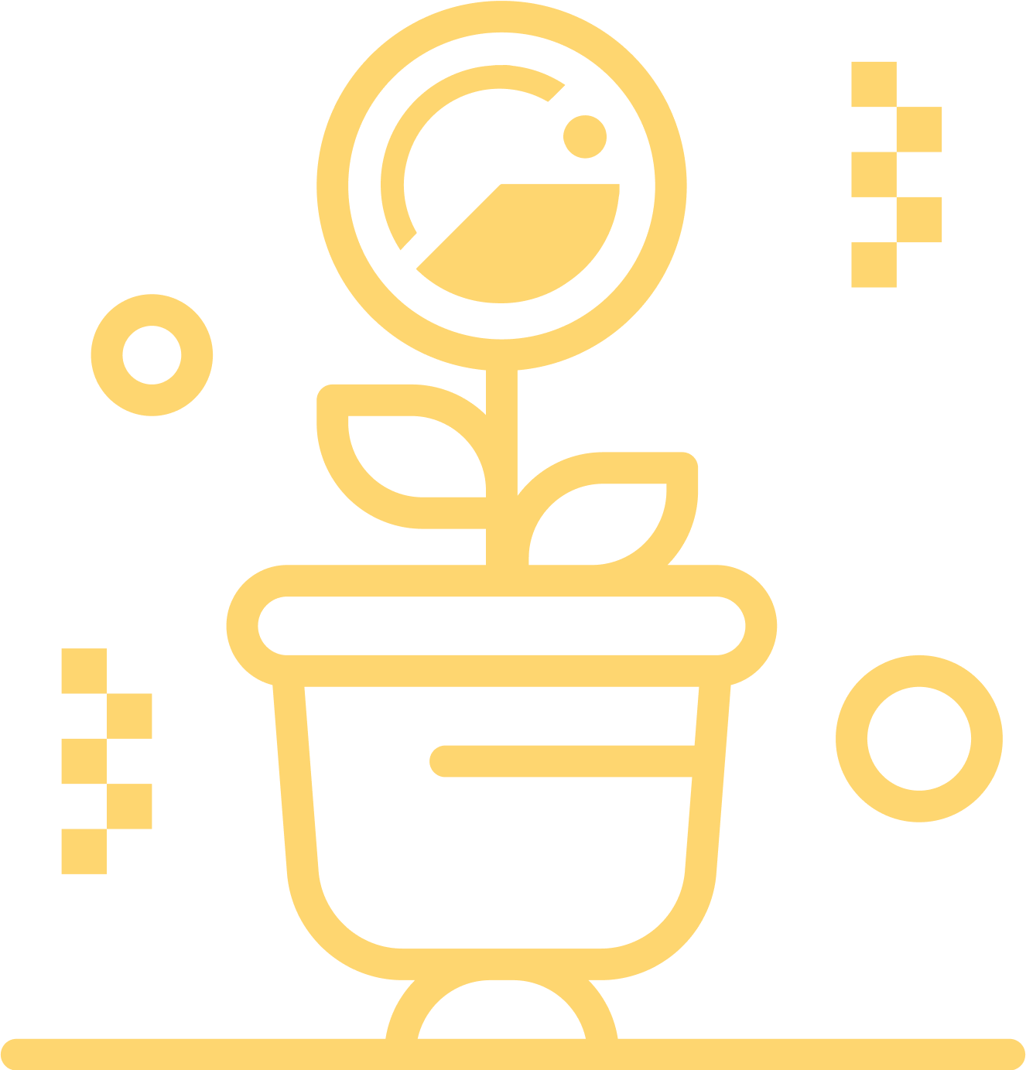
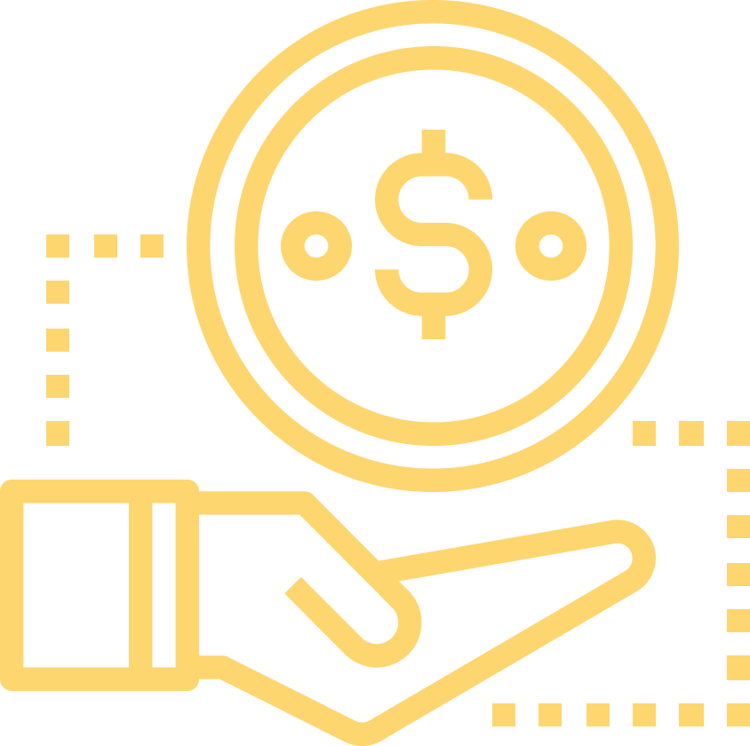
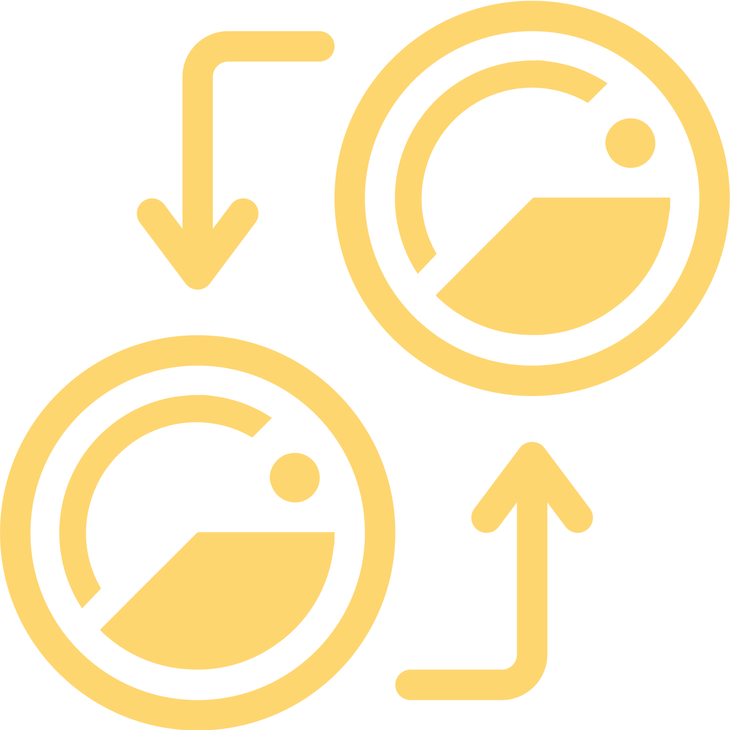
GIVfi has several pieces
Default of 5% of every donation donated to Giveth. (Can opt-out.)
GIVsavings: Projects can earn yield on donations they receive with a “set it and forget it” flow.
Fee switch integrated to base layer controlled by GIV token holders.
oneGIV gets integrated into the system to create demand for GIV.
GIVfi brings revenue and economic demand for the GIV token, but this is just the beginning.

Slide 19
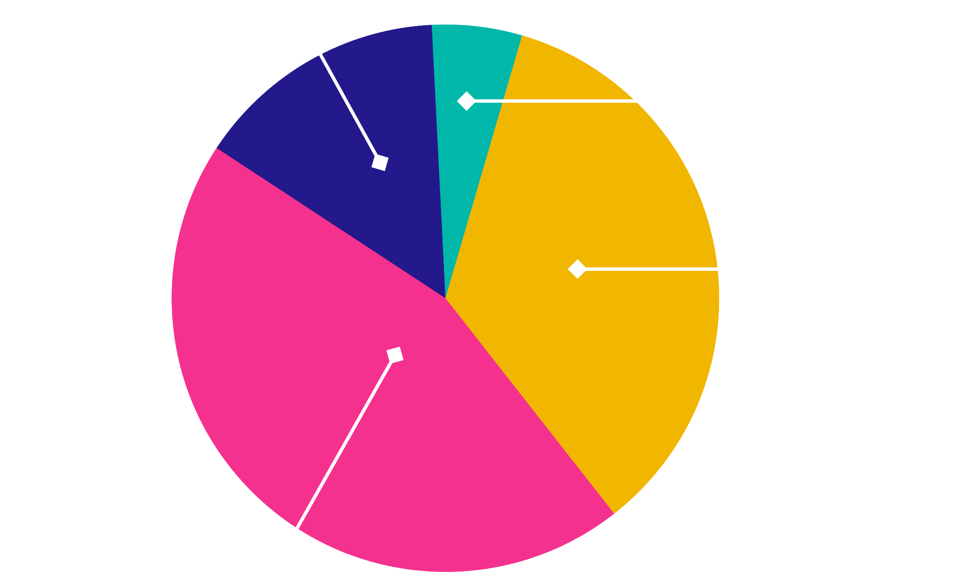
GIVfi Opens up GIVdowments
Choose where your interest streams
GIVfi opens up the ability for the nearly $2 trillion USD worth of tradfi endowments to easily start earning interest in defi and automate the allocation of those funds to projects on our platform. Also, any project can start their own GIVdowment, where 100% of the interest they earn goes straight into their project. This will beat any interest they could earn in a tradfi savings account by many multiples.
Environmental Matching Pool
Grassroots Economics
Refugee Support Matching Pool
Gitcoin Grants

Slide 20
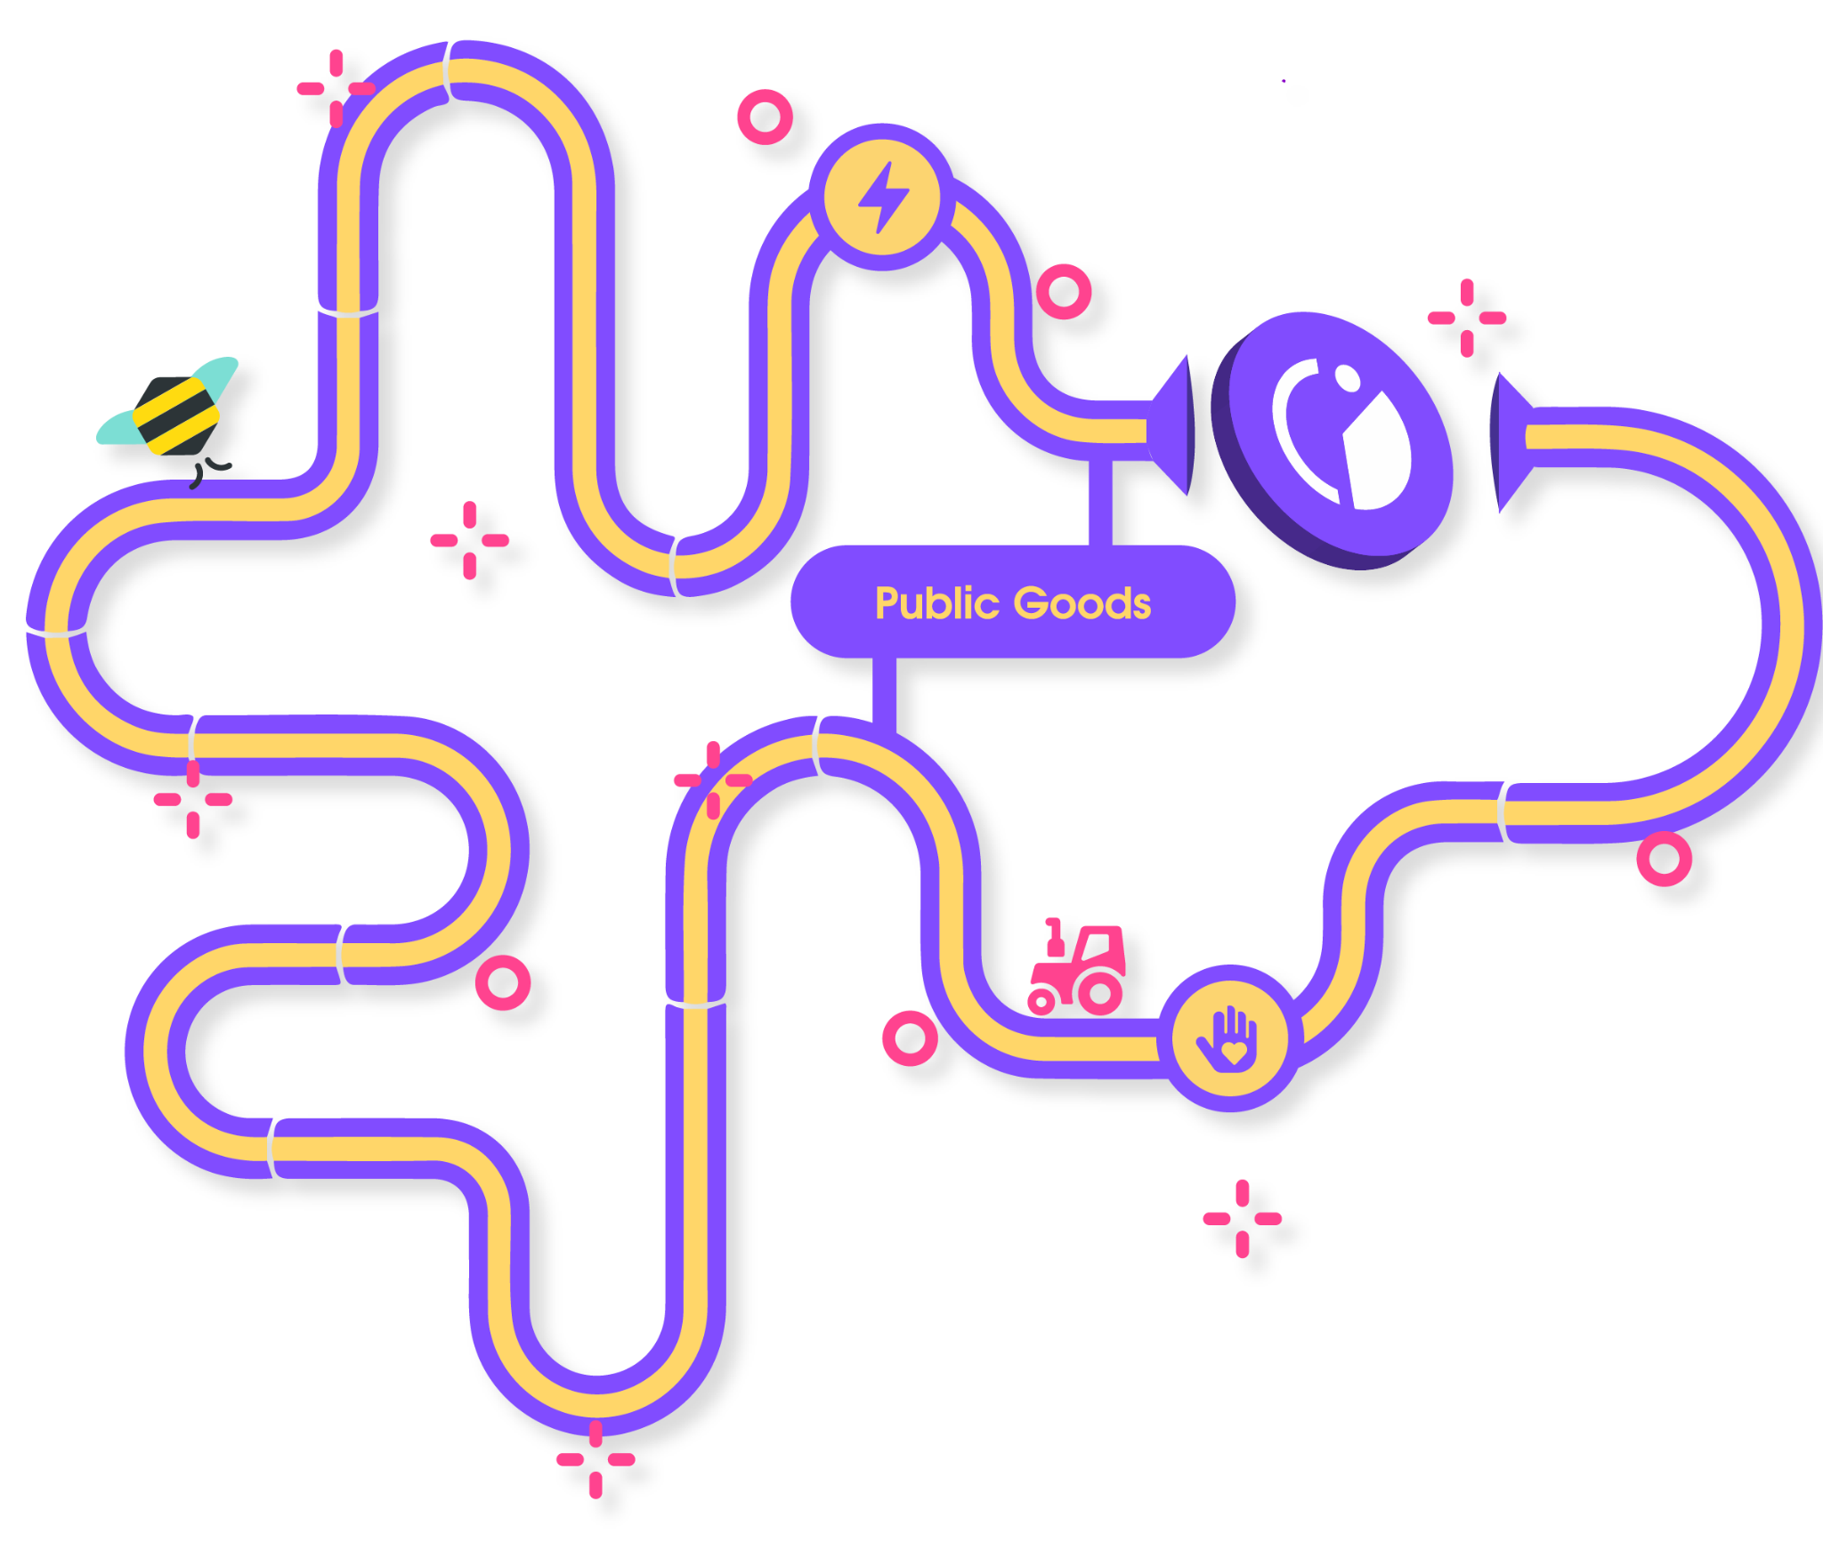

The Path to Gurves
Building regenerative
economies that KEEP
value within its community
Griff Green @thegrifft
Notes:
Gurves are the big dream of Giveth. Gurves turn donors into investors and volunteers into shareholders, coordinating all of the stakeholders around the nonprofit’s regen microeconomy. Ok i am going to skip over an explanation of Bonding how BC’s work… so if you don’t know, its ok, just believe me that this makes sense. Let’s say that Mutual Aid Mondays has ironed out the kinks around coordinating as a DAO with their reputation system and has become Mutual Aid Denver DAO and has 200k worth of GIVtokens staked behind it via GIVpower. They can start a Gurve.

Slide 21
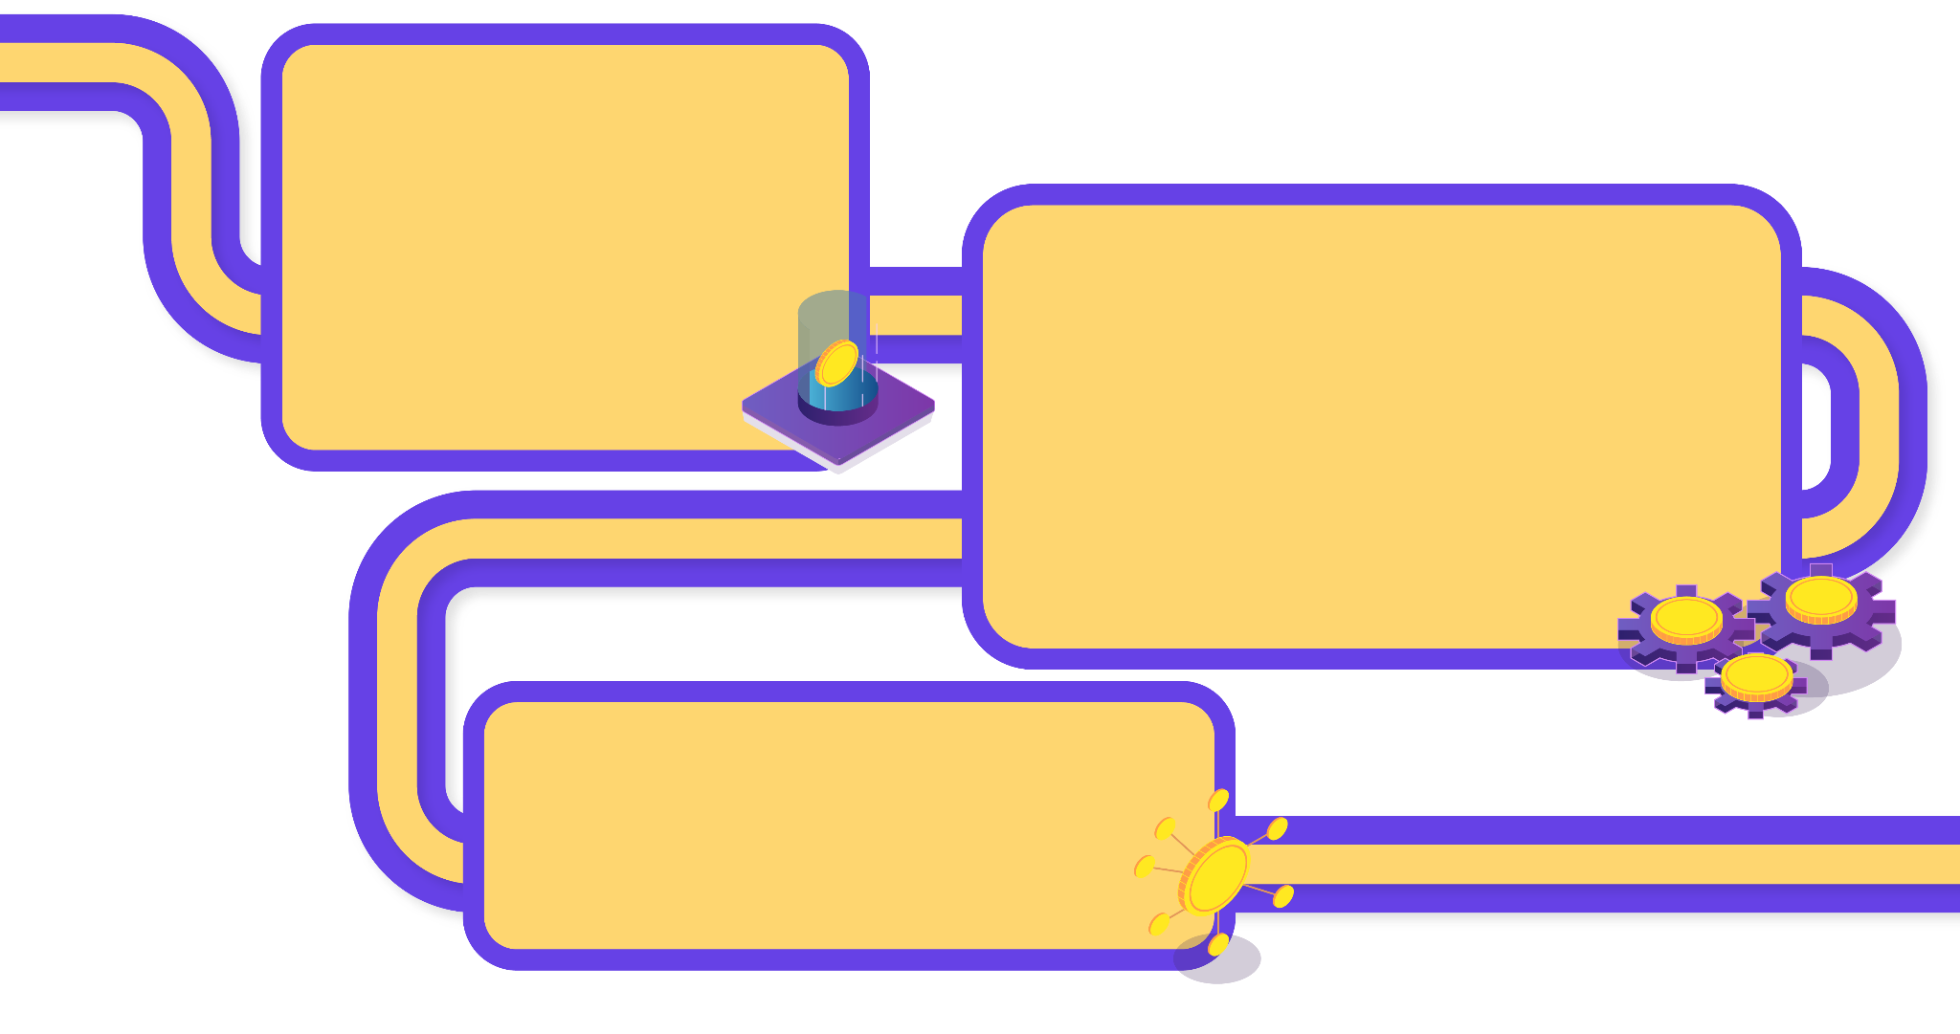
Gurves The Future of Giving is Investing
Gurves will transform Giveth from a donation platform into an impact investment platform. Innovators in the nonprofit space will be able to capitalize on their idea and find seed capital on the platform to create their own token, collateralized by GIV.
Traditional foundations will have an opportunity to diversify their endowments into novel impact investments. There were over $1.49 TRILLION USD in endowments in 2021 in the US alone*, and the number has likely grown since then. If only ¼ of 1 percent of these funds was allocated to impact DAOs on our platform, this would be over $4 billion USD of demand for GIV.
And that is only one of many potential organizations that would have an opportunity to invest in instead of donate to their favorite nonprofit causes.
Source: According to the
2021 NACUBO-TIAA Study of Endowments
Griff Green @thegrifft
Notes:
Gurves are the big dream of Giveth. Gurves turn donors into investors and volunteers into shareholders, coordinating all of the stakeholders around the nonprofit’s regen microeconomy. Ok i am going to skip over an explanation of Bonding how BC’s work… so if you don’t know, its ok, just believe me that this makes sense. Let’s say that Mutual Aid Mondays has ironed out the kinks around coordinating as a DAO with their reputation system and has become Mutual Aid Denver DAO and has 200k worth of GIVtokens staked behind it via GIVpower. They can start a Gurve.

Slide 22
Competition
There is no competition in public goods, and we love to work with everyone in the space to bring more value for public goods.
We are actively working with Gitcoin for example to integrate QF, and many projects on Giving Block can also raise on Giveth.
Features | Giveth | Gitcoin | Giving Block | Endaoment
Optional fees | Yes | Yes | No (they charge onboarding fee) | No (1.5% fee)
Rewarding scheme | GIVbacks, Tax exemption form (upon request) | No | Tax exemption form | Tax exemption form
Defi strategies for donors and projects | Farms, GIVpower, GIVfi, Gurves (coming soon) | Quadratic funding | no | Yield strategy
Multichain donations | Ethereum, Gnosis, Polygon. soon to launch: Celo, Optimism, ETC | Yes - customized based on rounds | Ethereum mainnet | Ethereum mainnet
Area of focus | 501(c)(3), web 3.0 | Web 3.0 | 501(c)(3) | 501(c)(3)
Scaling philanthropy | Regen microecnomies through Gurves (coming soon) | NA | NA | NA
Griff Green @thegrifft
Notes:
Competitors: The giving block, Endaoment (US centric), Gitcoin (Quarterly matching funds) [We will collaborate]

Slide 23
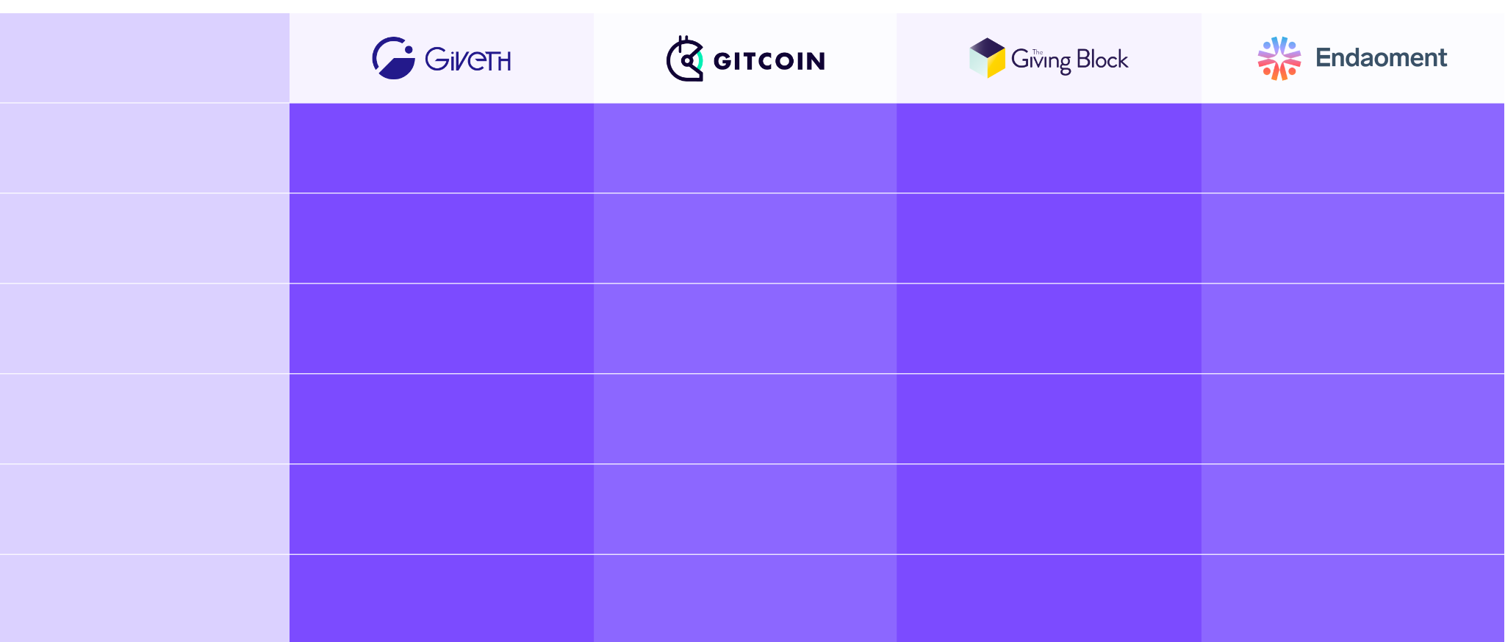
Competition
There is no competition in public goods, and we love to work with everyone in the space to bring more value for public goods. We are actively working with Gitcoin for example to integrate QF, and many projects on Giving Block can also raise on Giveth.
Features
Optional fees
Yes
Yes
No (they charge onboarding fee)
No (1.5% fee)
Rewarding scheme
GIVbacks, Tax exemption form (upon request)
No
Tax exemption form
Tax exemption form
Defi strategies for donors and projects
Farms, GIVpower, GIVfi, Gurves (coming soon)
Quadratic funding
No
Investment portfolios
Multichain donations
Ethereum, Gnosis, Polygon. soon to launch: Celo, Optimism, ETC
Yes - customized based on rounds
Ethereum mainnet
Ethereum mainnet
Area of focus
501(c)(3), web 3.0
Web 3.0
501(c)(3)
501(c)(3)
Scaling philanthropy
Regen microecnomies through Gurves (coming soon)
NA
NA
NA
Griff Green @thegrifft
Notes:
Competitors: The giving block, Endaoment (US centric), Gitcoin (Quarterly matching funds) [We will collaborate]

Slide 24
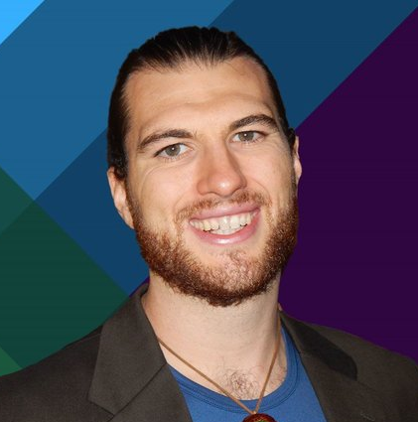

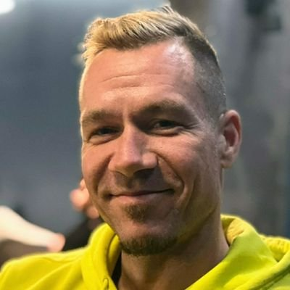
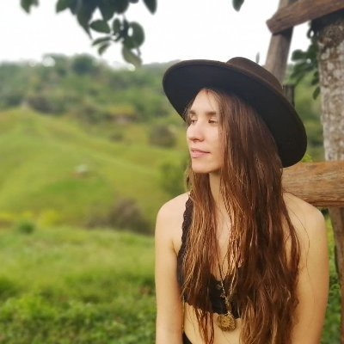
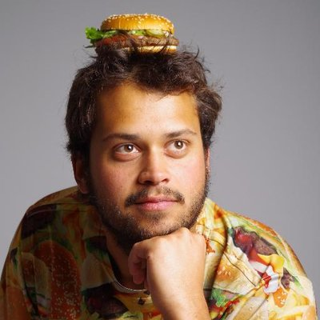


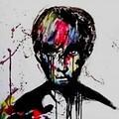
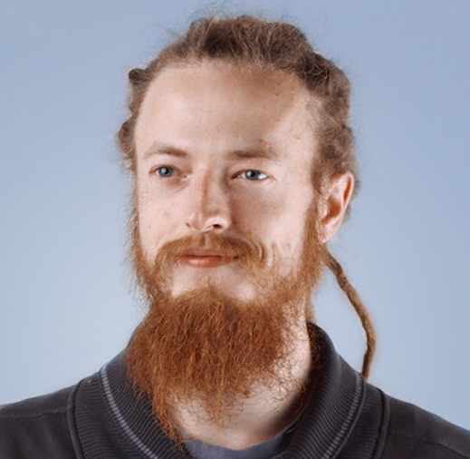
Giveth DAO
Griff Green
co-Founder of the Commons
Stack, Giveth.io. Also co-founder of DAppNode and White Hat Group (WHG).
Jordi Baylina
co-founder of Giveth, DAppNode
and founder and technical lead of Polygon Hermez’ zkEVM and iden3.
Marko Prljic
Product and UX design lead at
Giveth, co-founder of General Magic.
Lauren Luz
Giveth communications lead and GIVeconomy product manager.
Mitch @divine_comedian
DAO steward, DeGov expert,
DevOps and development assistant.
Willy Ogorzaly
Head of Decentralization at Fox Foundation. Former CEO @bitfract acq: ShapeShift @JustLegal acq: DigitalTown.
Eduardo Antuña
DAppNode co-founder and
project lead. Ethereum DevOps and Solidity developer.
Sem @404ouch
Software engineer at 1Hive, Giveth.
Smart contract developer. Building GIVpower.
Oleksii Matiiasevych
Ethereum architect,
smart contracts engineer.
…and 50+ Giveth contributors

Slide 25

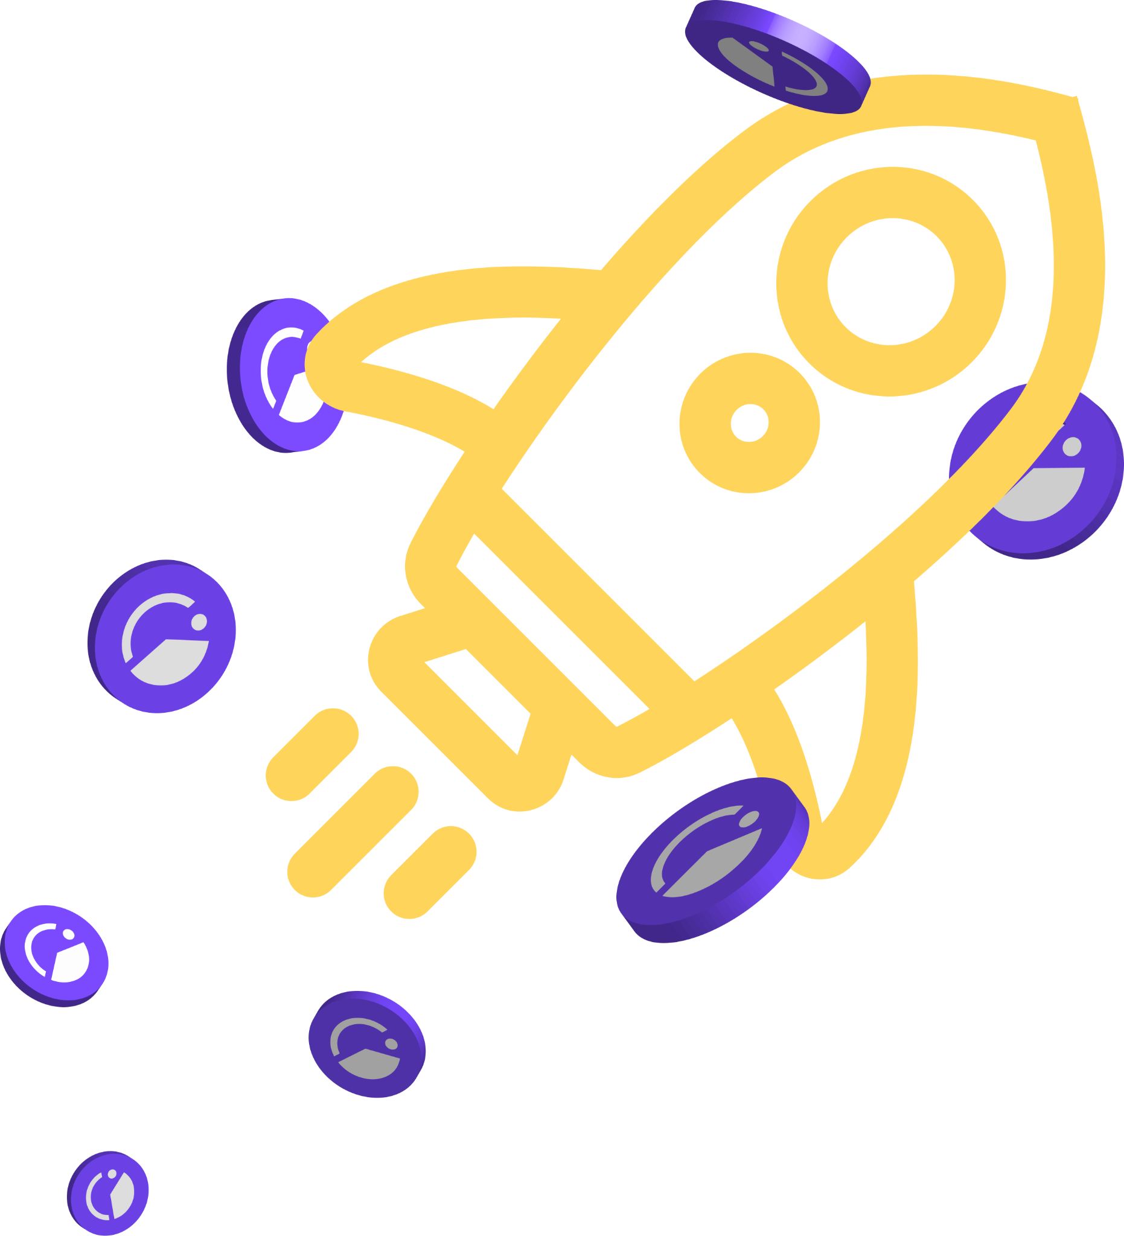
We are raising $2 mil USD
We are selling up to 12% of our token supply at a discount.
Get in touch to find out more!
Griff@giveth.io
TG: @GriffGreen

Slide 26
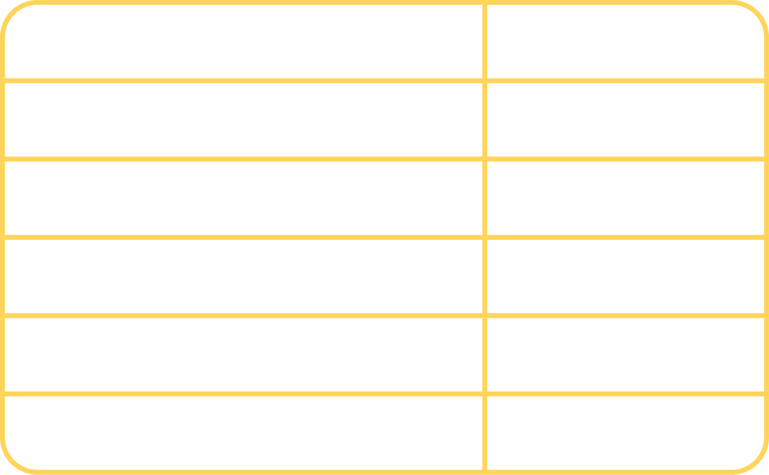
We are raising $2 mil USD
We are selling up to 12% of our token supply at a discount.
Buy GIV at a 20% discounted rate, and stake it with a higher reward in GIVpower while retaining governance.
We want to work with you to structure this opportunity. We are builders, and we need an investment perspective to finalize the structure of the offer.
Market cap
1.8 Mil USD
FDV
21 Mil USD
GIV price
$0.017
Discount
20%
Total GIV for sale
119 Mil
% of total supply
12%

Slide 27
Our tokenomics
Giveth is a decentralized, autonomous organization that issues its own native token, GIV.
$GIV has a supply cap of 1,000,000,000 units that has 3 year cliff, and vests for 3 years, after 6 years 100% will be liquid.
90% of the allocation was put in a stream that ends at the end of 2026, and 10% was allocated at launch (except the liquidity). Making the circulating supply only 5.6% of the total supply, and our market cap ~$2 million.
The token was launched at the end of 2021 and was allocated like so:
33% to the GIVgarden (the GIV token holder DAO)
27% to the nrGIV DAO, our reputation DAO (The Team)
17% to the GIVdrop (to crypto donors and public goods communities)
13% to the GIVbacks program (rewarding donors on the platform for 5 years)
10% for Liquidity via Farming and Token Swaps

Slide 28



Building the Future of Giving
Our intention is to support and reward the funding of public goods by creating open, transparent and free access to the revolutionary funding opportunities available within the web3 ecosystem.
DAO & TECHNICAL METRICS
TREASURY & COMMUNITY
Product/service: Giveth, GIVmatching, Regen farms, GIVpower, GIVstream, GIVfi
Age: 6 years
Legal structure: DAO (builders across North America, Central America, South America, Europe, Middle-East, Asia)
Treasury structure: Safes on Mainnet and Gnosis Chain (diversified), GIVgarden, nrGIV
Revenue streams: Grants, donations, and soon interest generated by GIVfi - Potential for fees on donations when we scale.
Core architecture: https://github.com/Giveth/giveth-docs
Voting: GIVpower Boosting, Snapshot, Gardens, AragonDAO, Tokenlog
No. of proposals: +150
Proposal threshold: 1 million GIV quorum on Snapshot
Vote participation: ~3-5% of eligible GIV
Token distribution: 1 billion total supply; ~70 million GIV currently circulating distributed through GIVdrop, GIVbacks, GIVfarm & GIVstream
Governance Token holders: 1,291 addresses
Active members: 72
Commitment of contributors: Several contributor levels (stewards, senior token engineers, senior smart contract developers), In total approx 24 FTEs + 30 PTEs + 18 regular active community contributors paid project to project or volunteering
Social Media outreach: 11k Twitter followers
Griff Green @thegrifft
Notes:
Gurves are the big dream of Giveth. Gurves turn donors into investors and volunteers into shareholders, coordinating all of the stakeholders around the nonprofit’s regen microeconomy. Ok i am going to skip over an explanation of Bonding how BC’s work… so if you don’t know, its ok, just believe me that this makes sense. Let’s say that Mutual Aid Mondays has ironed out the kinks around coordinating as a DAO with their reputation system and has become Mutual Aid Denver DAO and has 200k worth of GIVtokens staked behind it via GIVpower. They can start a Gurve.

Slide 29

Join us in Building the
Future of Giving

Slide 30
APPENDIX
Giveth history
Crypto charity market outlook
Successful projects on Giveth
GIVeconomy & Token info
GIVdrop
GIVbacks
GIVstream
GIVgarden
Regen farms

Slide 31

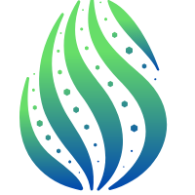

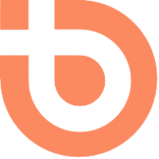
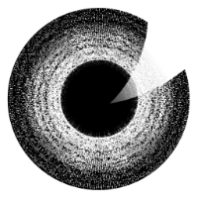

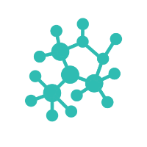
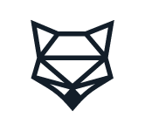
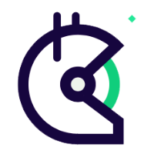


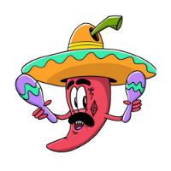
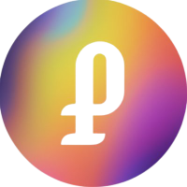


Our partners
1Hive
Commons Stack
Aragon
BrightID
The DAOist
ICHI
DappNode
Gnosis
ShapeShiftDAO
Gitcoin
Token Engineering Commons
Maker DAO
MetaCartel
Panvala
PrimeDAO
and more…

Slide 32
History of Success
‘16
‘17
‘18
‘19
‘20
‘21
• Founded by Griff Green, Jordi Baylina, and members of the White Hat Group
• Created Minime Token contract (used by Aragon, Status, etc. and forked by Compound)
• First project website launch
• Donation Application (DApp) launched - enabling traceable & accountable donations to for-good campaigns
• Giveth officially introduced as a DAC, introducing a new governance structure for the DAO
• Creation of Reward DAO: a system to reward contributors for their work, now called Praise
• Organized ScalingNow! Conference to address Ethereum scaling issues
• Won 1st place at Edcon’s Super Demo in Toronto
• Launched Giveth Trace in beta, one of the first multichain DApps with a bridge to Rinkeby
• Supported the launch of xDai, as one of 4 founding validators
• Commons Stack spun out of Giveth: a partner project designed to help with Giveth’s vision of Regenerative Microeconomies
• Augmented Bonding Curve designed
• Conviction Voting designed
• Work begun on building Token Engineering Commons
• Giveth Trace exigraduated out of beta with better functionality and streamlined UX
• Giveth’s reputation DAO launched using “Soul-bound tokens” now known as nrGIV DAO
• New donation application built with simple peer-to-peer donations on both Mainnet and xDai (now Gnosis Chain)
• Launch of GIVeconomy and GIV. Live: GIVfarm, GIVstream and Conviction Voting
• Giveth now governed by holders of GIV and nrGIV
• Giveth in full-swing with functioning tokenization platform

Slide 33
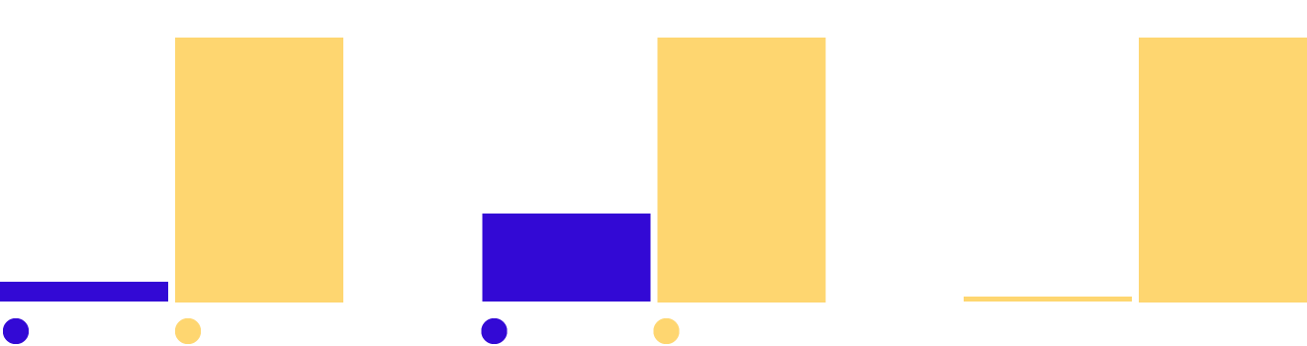
45% of crypto users donate at least $1,000 to charity annually
…while only 33% of the general investor population gives $1,000 or more to charity annually. This fact suggests that the average crypto donor is uniquely generous, as compared to the average cash donor.
Given the crypto market outlook, user and nonprofit adoption growth, and innovations in fundraising, crypto has the potential to become the most powerful philanthropic force on the planet in the years ahead.
In 2021, the largest source of charitable giving came from individuals, who gave $326.87 billion, representing 67% of total USD giving.
Overall Cryptocurrency Donation Volume
Total Annual Volume of Cryptocurrency Donations (USD)
The Value of an Average Crypto Donation
Mean Average Cryptocurrency Donation Size
Donations: Crypto vs. Cash
Average Cryptocurrency Donation vs. Average Online Cash Donation
16x
236%
82x
Source: 1. Growing popularity of cryptocurrency could fuel charitable giving (Fidelity Charitable) 2. Charitable Giving Statistics 3. The giving block annual report

Slide 34

GIVpower
A win-win opportunity for donors & projects
Griff Green @thegrifft

Slide 35
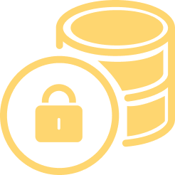


How does GIVpower work?
Stake & lock GIV to get GIVpower & earn a yield
Boost your favorite
projects
Donors to top projects get more GIVbacks
Griff Green @thegrifft
Notes:
Governance without voting…

Slide 36
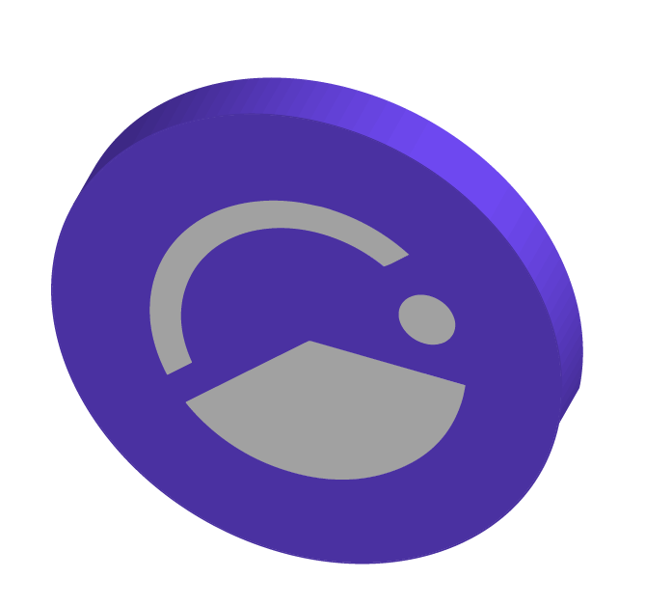
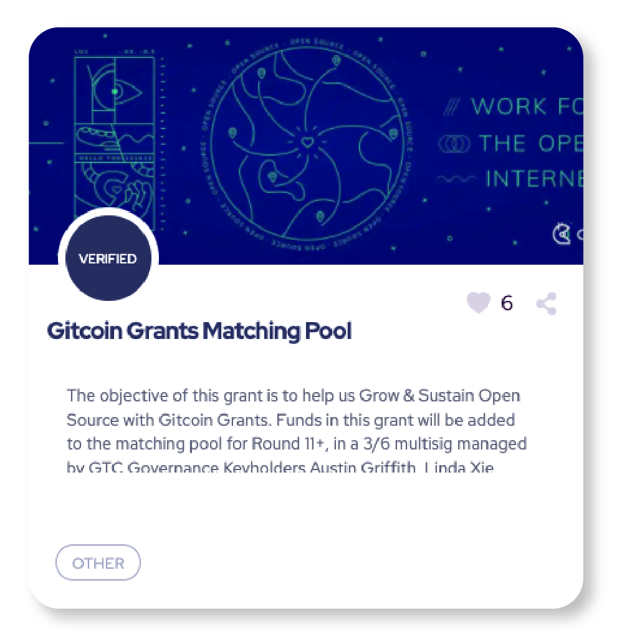
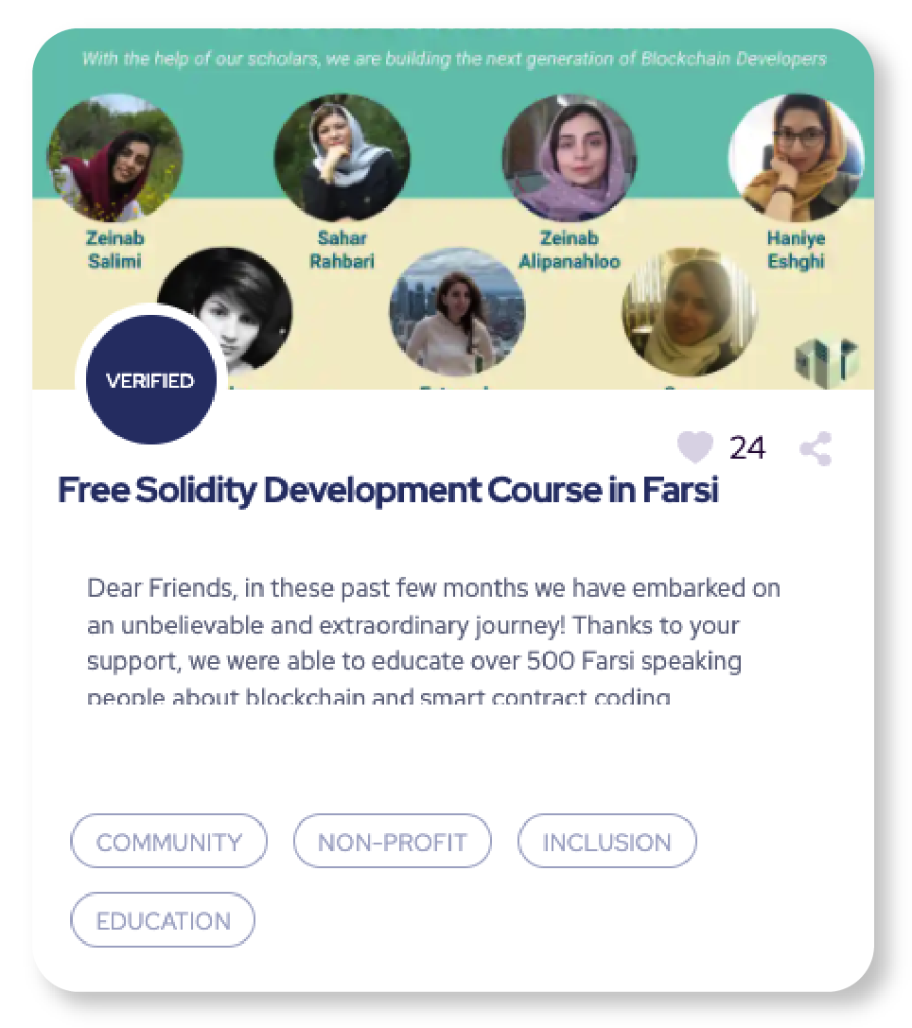
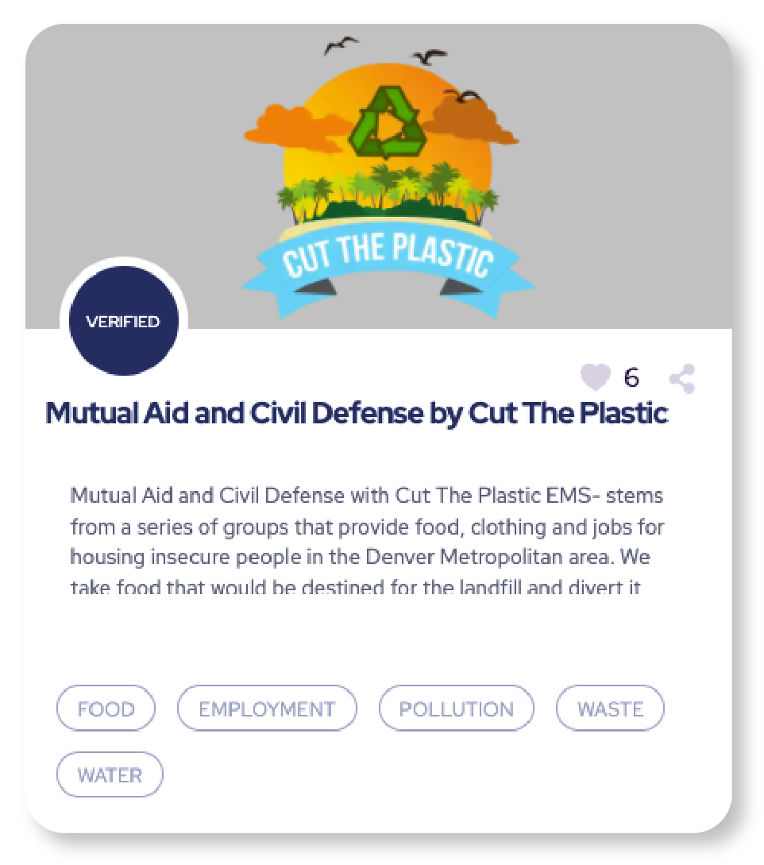
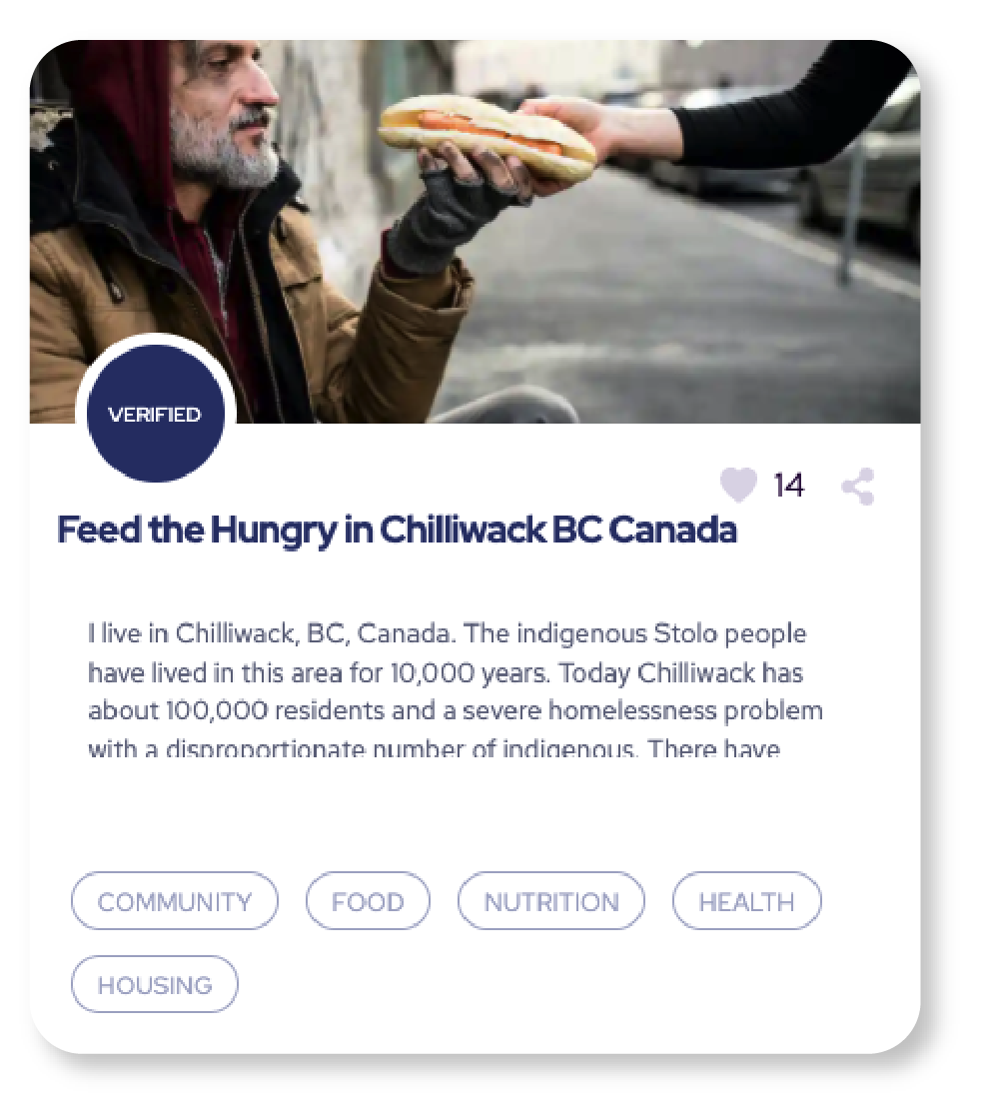





Projects
become reputation DAOs
Griff Green @thegrifft
Notes:
When Projects on Giveth start to have a lot of GIV tokens staked behind them, we will reach out and help them create a rewards system so their community can learn to DAO. This will start out as just a reputation system, but it will allow the nonprofit to start to collectively implement their own economic game, they can start to give points to their underpaid staff and volunteers, their expert advisors, and their donors on Giveth. Every successful Regen economy will need to design a system that rewards expertse, labor and capital in the right balance. To be successful, and this is our current plan on how to kickstart it, for legacy nonprofits. Once the project has a working reputation system then they can start to collectively govern their donations via their very own DAO, and then if they are winning the GIVpower game, then we can bring out the GURVES!

Slide 37



Praise
Acknowledge and reward community contributions, and build a culture of giving and gratitude.
Notes:
Praise is a reward system that invites communities to build a culture of giving and gratitude, involving contributors at every step of the process.
Praise allows communities to acknowledge the full spectrum of value created - ranging from small to large contributions. With praise we are not locking a top down value system in place, but we are constantly listening to what the community does value.
Praise works in 4 steps

Slide 38
Gurves
Griff Green @thegrifft
Notes:
Gurves are the big dream of Giveth. Gurves turn donors into investors and volunteers into shareholders, coordinating all of the stakeholders around the nonprofit’s regen microeconomy. Ok i am going to skip over an explanation of Bonding how BC’s work… so if you don’t know, its ok, just believe me that this makes sense. Let’s say that Mutual Aid Mondays has ironed out the kinks around coordinating as a DAO with their reputation system and has become Mutual Aid Denver DAO and has 200k worth of GIVtokens staked behind it via GIVpower. They can start a Gurve.

Slide 39
Gurves are Only Given to the Best!
The projects with the most GIV locked behind them will be supported in DAOifying their project, first with a reputation DAO, governing their donations. When that succeeds, and a strategy for creating demand for a token can be structured, then we will help that project launch a Gurve. This mimics a traditional investment pattern but with advanced token engineering patterns built in, for integrating donations and investments together.
GIVpower becomes seed collateral. The GIV locked behind the project can collateralize the issuance of a new token for the project via a Giveth bonding curve aka Gurve. These 1st supporters get discounted PROJ.
Hatch as a Series A. Additional capital for a project’s DAO can be raised right before launch. All $PROJ issued at launch will be locked.
$PROJ distributed fairly. The community supporting the project as a nonprofit has earned reputation tokens and will be given locked $PROJ. Labor, expertise and capital all have upside and shared success.
Continuous Series B. Anyone can now invest into the DAO by sending GIV to the Gurve to issue liquid PROJ, raising the price of PROJ.

Slide 40

Griff Green @thegrifft
Notes:
Let’s assume a Bancor style bonding curve with a reserve ratio of 20% (liek what the TEC has) this means that the 200k worth of GIVtokens would collateralize a $1million dollars worth of Mutual Aid tokens. So now with that $1 million dollars, lets just do simple math and give ⅓ of to the GIVpower stakers and ⅓ of it to the reputation holders and 1/3rd of it to the Mutual Aid DAO itself. There is a lot of nuance her that I am skipping and we are learning about via the Commons Stack’s applied research… but in the interest of time, i will continue.

Slide 41

Gurves
Griff Green @thegrifft
Notes:
Gurves are the big dream of Giveth. Gurves turn donors into investors and volunteers into shareholders, coordinating all of the stakeholders around the nonprofit’s regen microeconomy. Ok i am going to skip over an explanation of Bonding how BC’s work… so if you don’t know, its ok, just believe me that this makes sense. Let’s say that Mutual Aid Mondays has ironed out the kinks around coordinating as a DAO with their reputation system and has become Mutual Aid Denver DAO and has 200k worth of GIVtokens staked behind it via GIVpower. They can start a Gurve.

Slide 42

Griff Green @thegrifft
Notes:
Gurves are the big dream of Giveth. Gurves turn donors into investors and volunteers into shareholders, coordinating all of the stakeholders around the nonprofit’s regen microeconomy. Ok i am going to skip over an explanation of Bonding how BC’s work… so if you don’t know, its ok, just believe me that this makes sense. Let’s say that Mutual Aid Mondays has ironed out the kinks around coordinating as a DAO with their reputation system and has become Mutual Aid Denver DAO and has 200k worth of GIVtokens staked behind it via GIVpower. They can start a Gurve.

Slide 43

GIVbacks
Where giving gives back
Griff Green @thegrifft
Notes:
GIVbacks is a revolutionary concept that rewards donors to verified projects with GIV tokens. When you give to verified projects you get GIV tokens and you get a Stream of GIV tokens for the next 4 years. This means that not only does Giveth reward you for donating, if the GIV token price goes up, you could actually make more money than you donated! What more could you want?

Slide 44


Giveth offers lucrative rewards to donors while attracting and rewarding long-term holders
The GIVfarm provides various liquidity farms on Mainnet and Gnosis Chain - as well as single asset GIV staking on Gnosis Chain.
The APRs are high without hurting our economy in the short term because of our GIVstream. When you harvest rewards from the GIVfarm you are not only earning instantly claimable rewards but also receiving and augmenting your own personal continuous stream of GIV.

Slide 45

GIV is the governance token that fuels and directs the GIVeconomy
Our community can participate in the GIVeconomy in the following ways:
From December 24, 2021 onward, eligible recipients can claim their GIVdrop on Gnosis Chain.
Donors to verified projects on Giveth get rewards from GIVbacks.
Liquidity providers and stakers can earn rewards in the GIVfarm.
All GIV holders can create and/or vote on proposals in the GIVgarden.
Anyone who claims GIV from their participation in the GIVeconomy gets a continuous flow of GIV from the GIVstream until December 23, 2026.
An amount of 1 billion GIV tokens were minted at the onset of the GIVeconomy. 90% of the GIV was put into the GIVstream and is being released continuously throughout the entire "GIViverse" over a period of 5 years (until December 23, 2026).
The distribution of the total supply of GIV throughout the GIViverse

Slide 46

The GIVstream aligns community members with the long term success of Giveth and the GIVeconomy
With the GIVstream, anyone who adds value to the GIVeconomy receives GIV continuously for up to 5 years from the GIVeconomy launch date.
GIV is rewarded through participation in the GIVeconomy, part will be liquid and part will add to GIVstream flowrate. As the GIVeconomy grows & stabilizes, more GIV becomes liquid and available for everyone.
GIVstream flowrate is the rate (GIV/week) at which GIV becomes liquid.
On Gnosis Chain, GIVstream flowrates are given (or increased) by donating and getting GIVbacks, wrapping GIV to use in the GIVgarden, or staking in the GIVfarm;
on Ethereum Mainnet by providing Mainnet liquidity and staking GIV or LP tokens in the GIVfarm on Mainnet.
The GIVstream nurtures the GIVeconomy at inception by having only 10% of the total supply of GIV liquid and transferrable to start.

Slide 47
The GIVgarden, the DAO governance platform
Giveth has chosen the Gardens DAO governance platform developed in partnership with 1hive to allow GIV token holders to manage the DAO configurations and allocate funds to projects that are aligned with its mission, vision and values.
The main tools used for governance in the GIVgarden are Conviction Voting and Tao Voting.
The unique feature of Conviction Voting is that, instead of voting yes or no on proposals, you stake GIV behind proposals that align with your values.
Tao Voting is a YES/NO decision making tool, with the option of delegation, that is used in the GIVgarden to make important, non-financial decisions for the DAO: updating DAO parameters, fixing bugs, adding new features to the DAO and/or for emergency situations such as an attack to the DAO treasury.

Slide 48
The next generation of ReFi Opportunities
Giveth is re-engineering charitable giving by creating a free, open-source platform, built on Ethereum and compatible with any EVM-Chain.
RegenFarms is the next generation of ReFi liquidity mining opportunities for DAOs and regens alike. Using our contracts for the GIVfarm and the GIVstream, we are empowering other for-good DAOs to launch liquidity mining incentive programs, “RegenFarms”, with streams of their own.
Shapeshift, CultDAO & recently The Standard have all paid to be part of this program.

Slide 49


RegenFarms presents the next generation of ReFi liquidity mining
Using our contracts for the GIVfarm and the GIVstream, we are empowering other for-good DAOs to launch liquidity mining incentive programs, “RegenFarms”, with streams of their own.
How?
Utilizing the GIVstream, all rewards earned in the GIVfarm (until December 23, 2026) include some part liquid and some part streaming. This allows the GIVfarm to offer high APRs without creating excessive sell pressure. Thanks to the GIVstream, Giveth has pioneered an elegant evolution to traditional liquidity mining that offers lucrative rewards while attracting and rewarding long-term hodlers, and keeping participants invested in the project for years to come.
We are now offering this technology as a service to other Blockchain4Good DAOs.
Shapeshift and CULTDAO’s RegenFarm are open for deposits and earning rewards.

